Slide 1
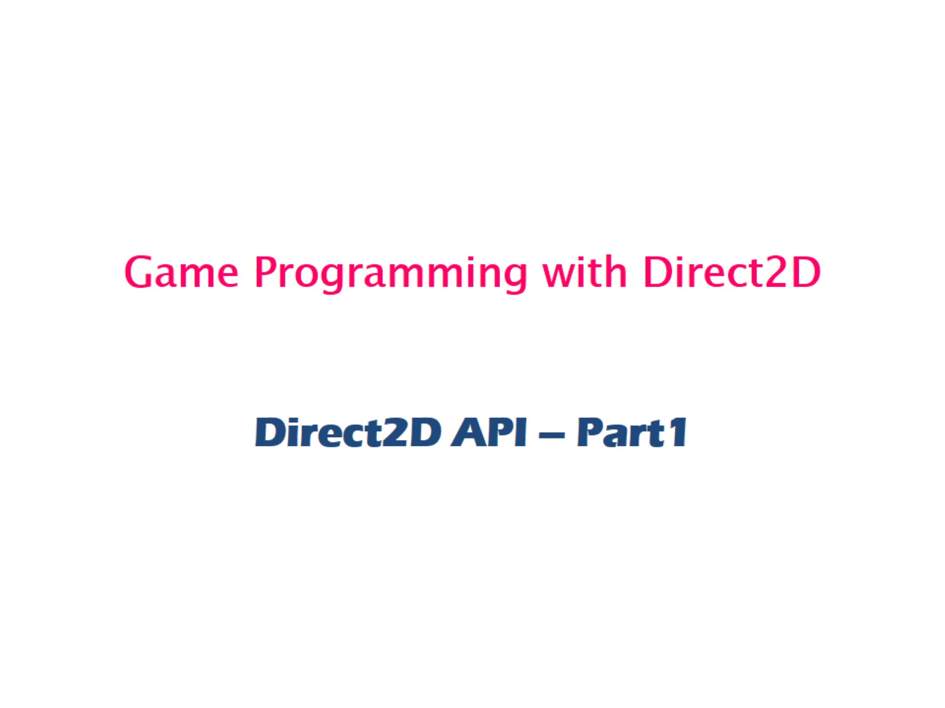
Game Programming with Direct2D

Slide 2
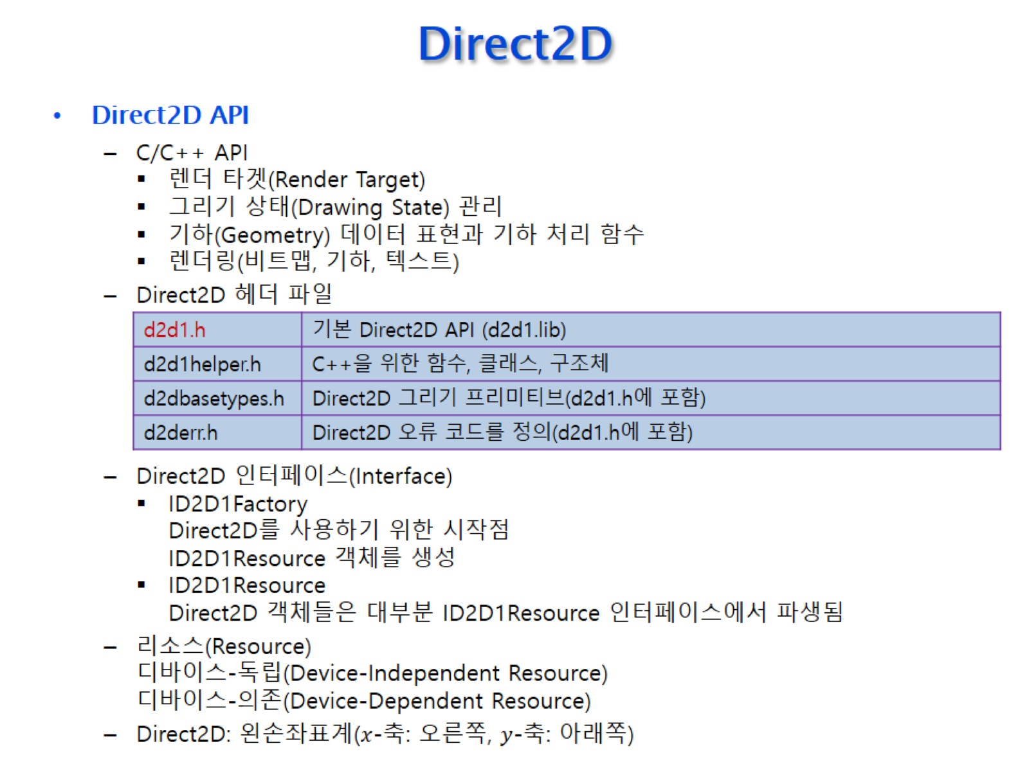
Direct2D

Slide 3
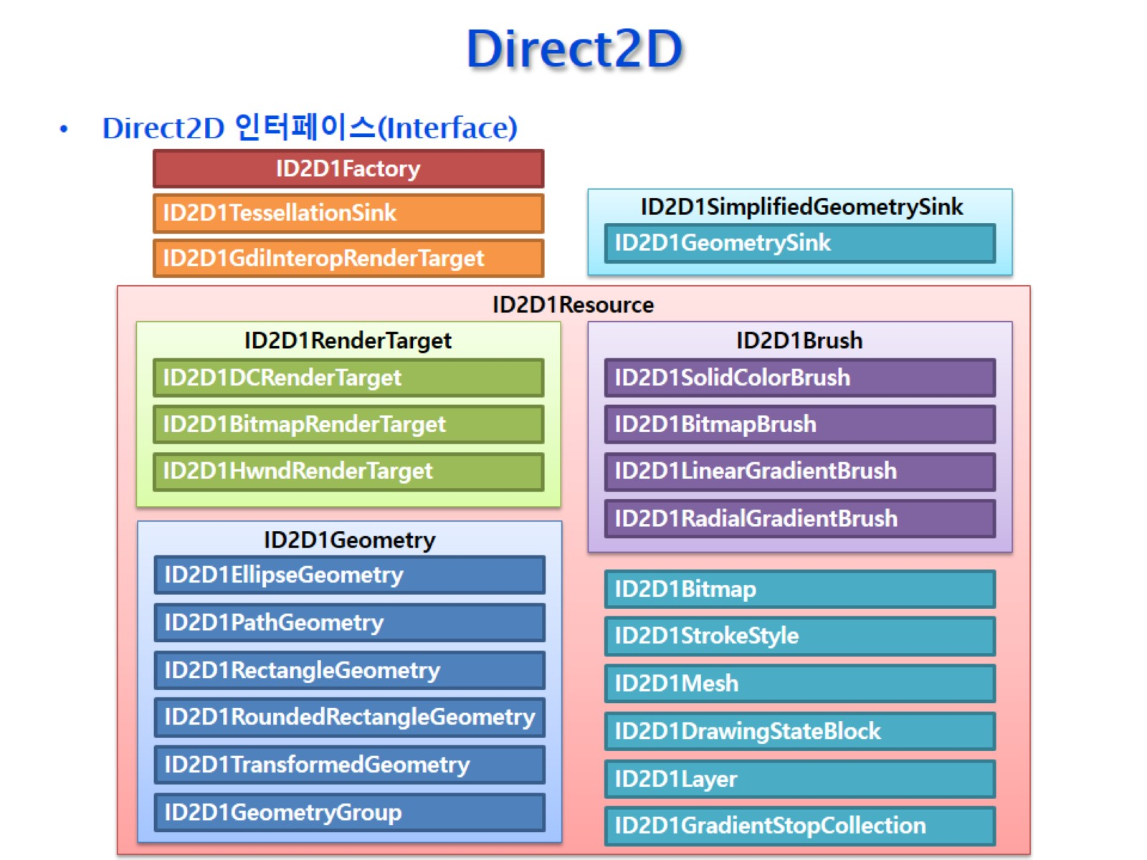
Direct2D

Slide 4
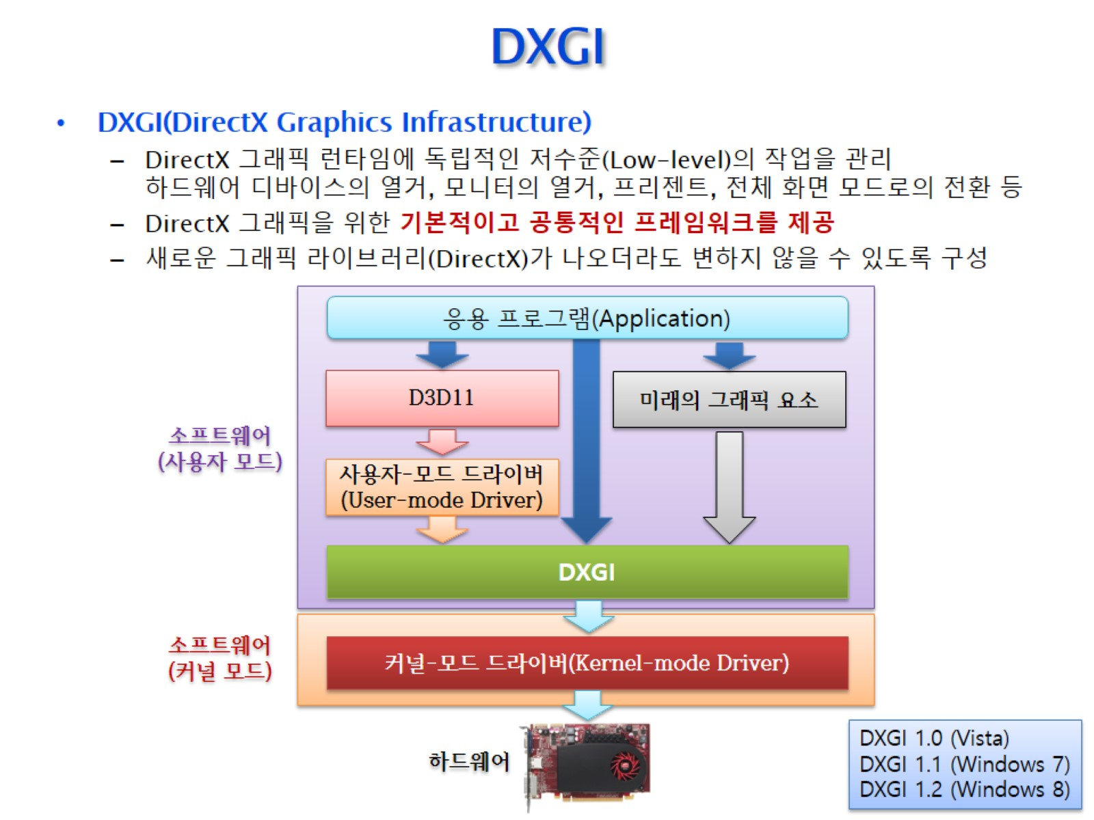
DXGI

Slide 5
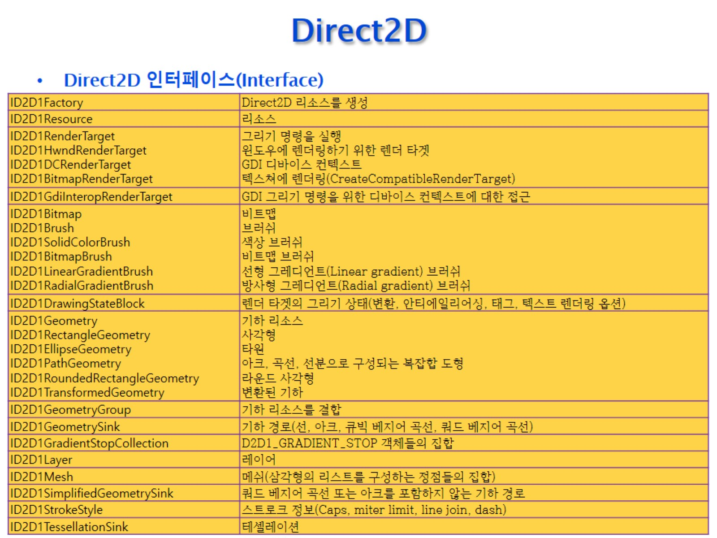
Direct2D

Slide 6
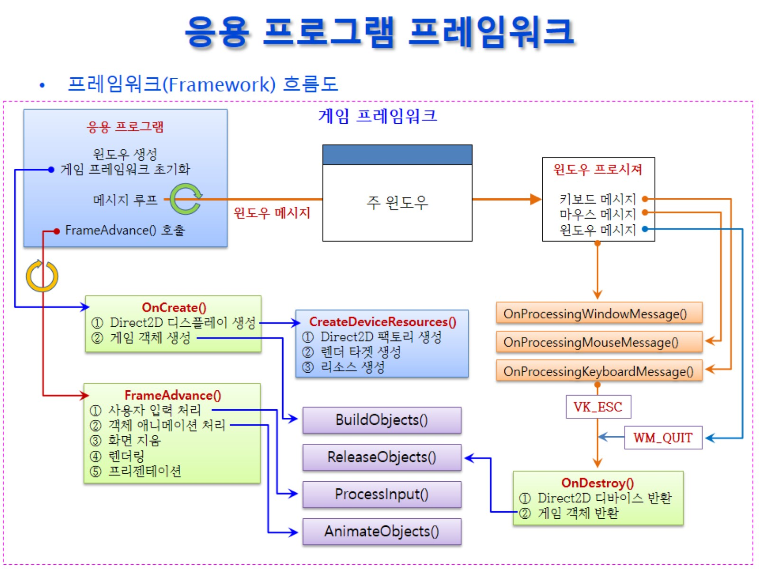
응용 프로그램 프레임워크

Slide 7
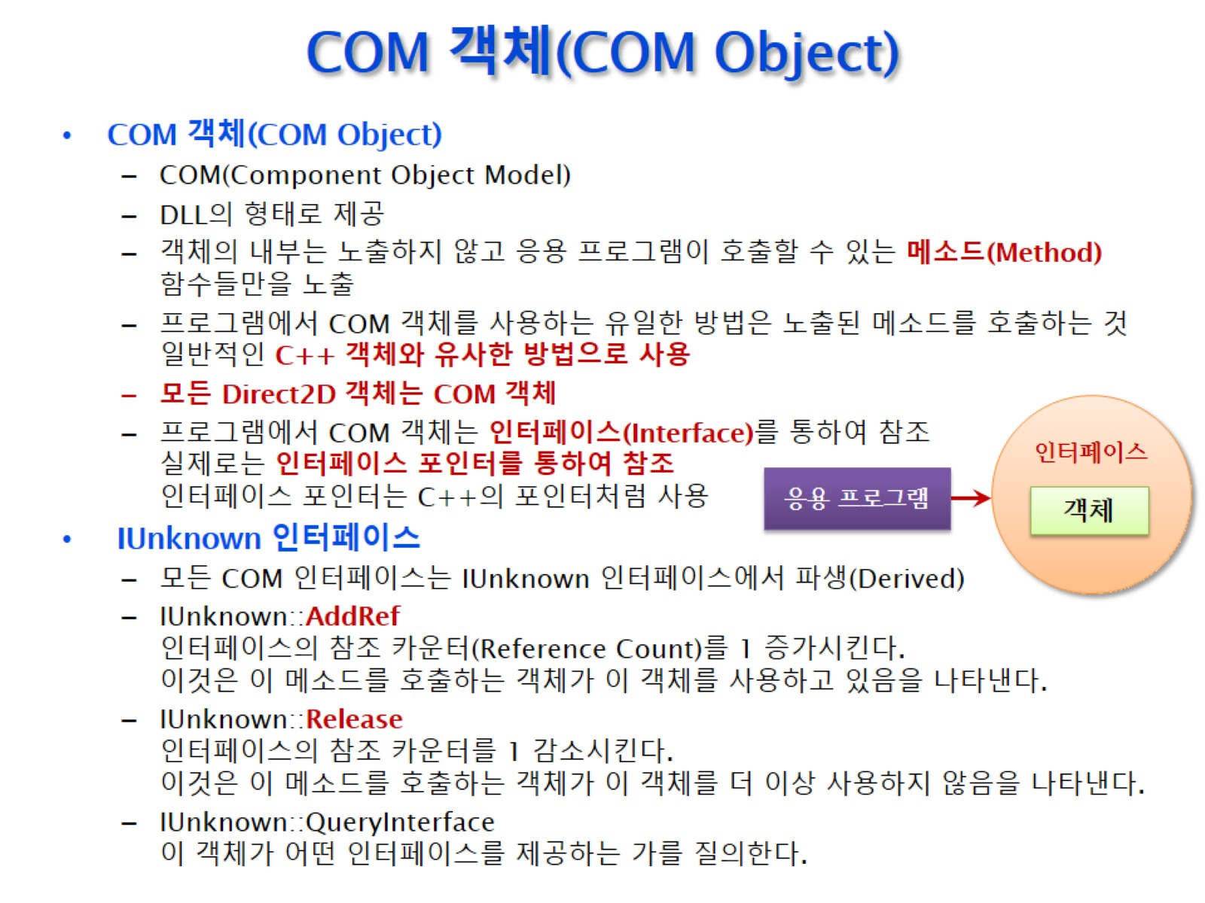
COM 객체(COM Object)

Slide 8
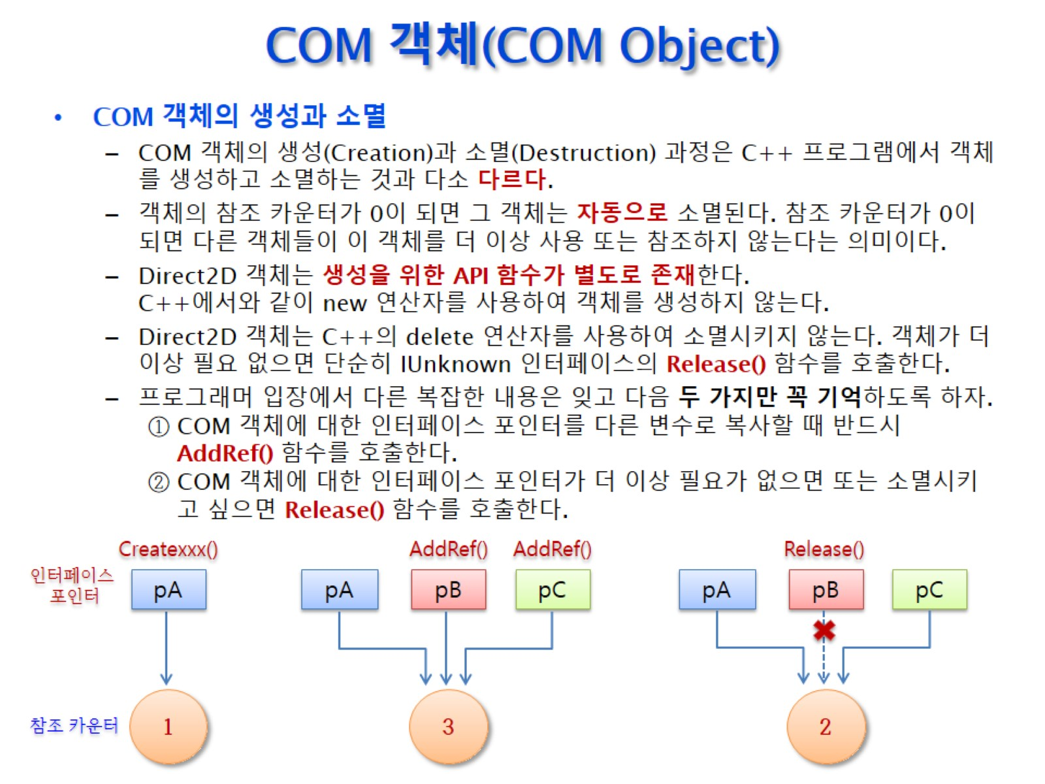
COM 객체(COM Object)

Slide 9
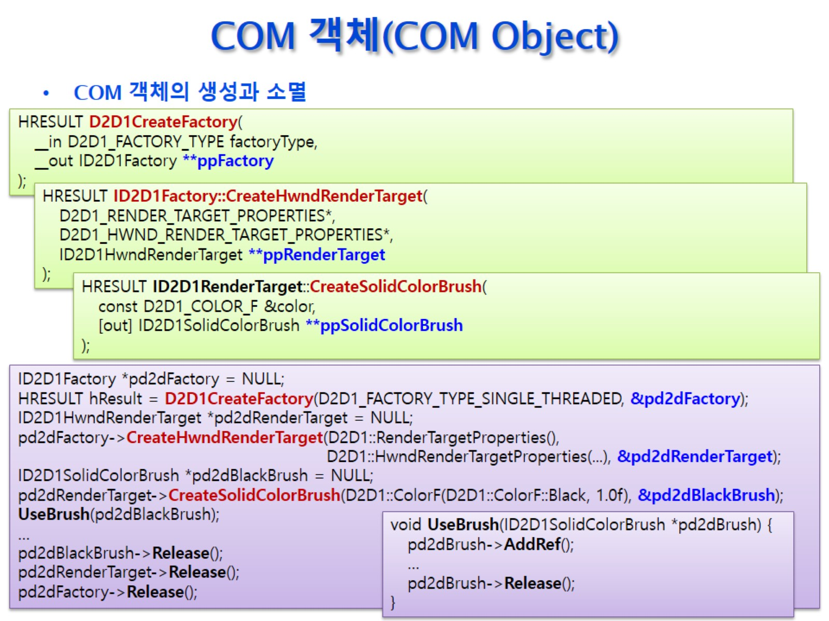
COM 객체(COM Object)

Slide 10
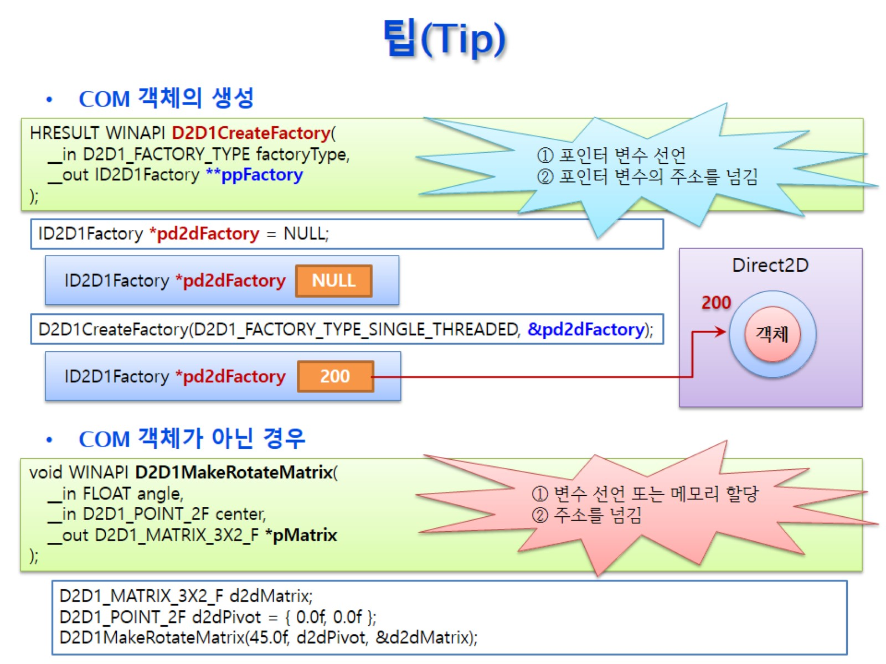
팁(Tip)

Slide 11
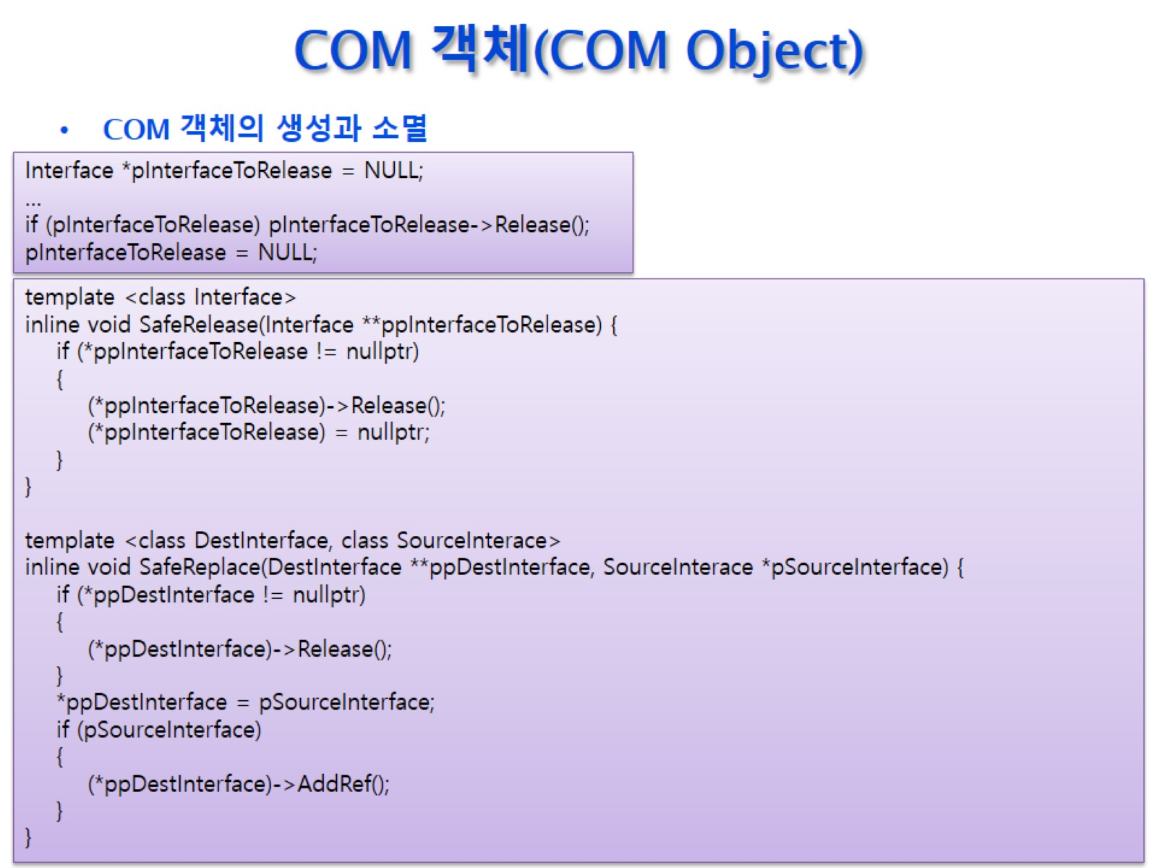
COM 객체(COM Object)

Slide 12
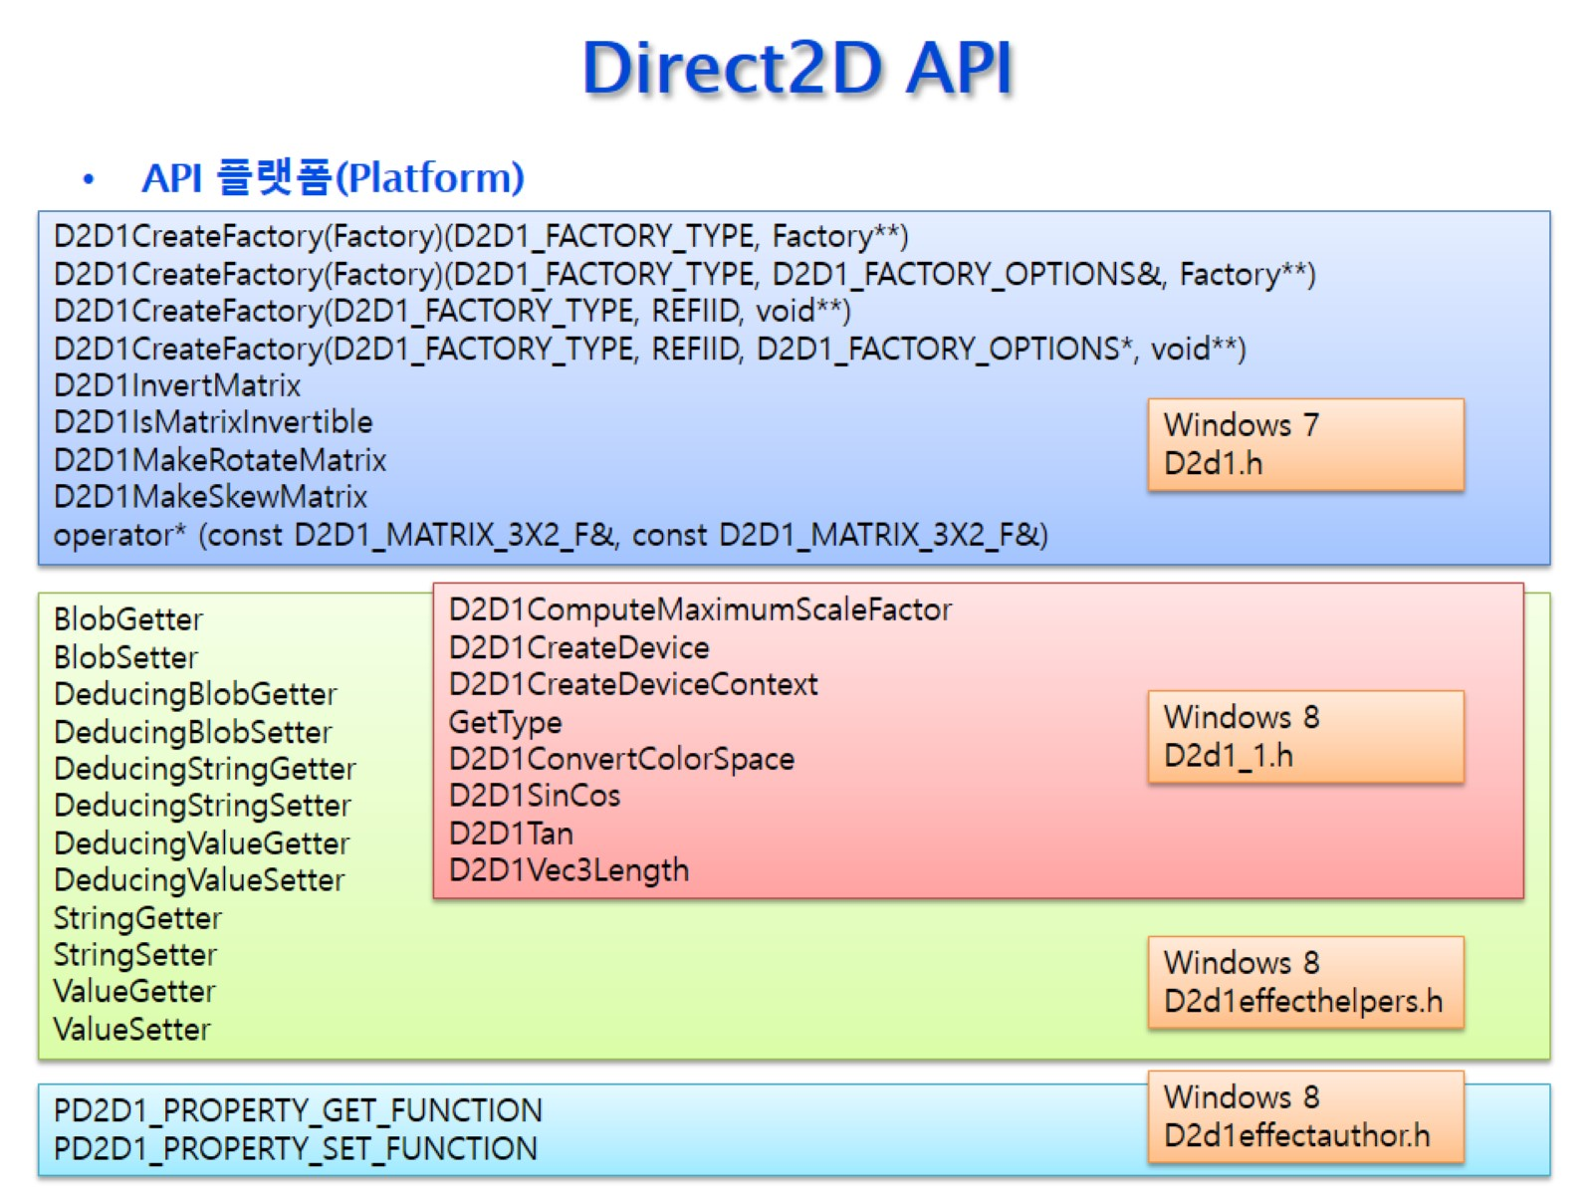
Direct2D API

Slide 13
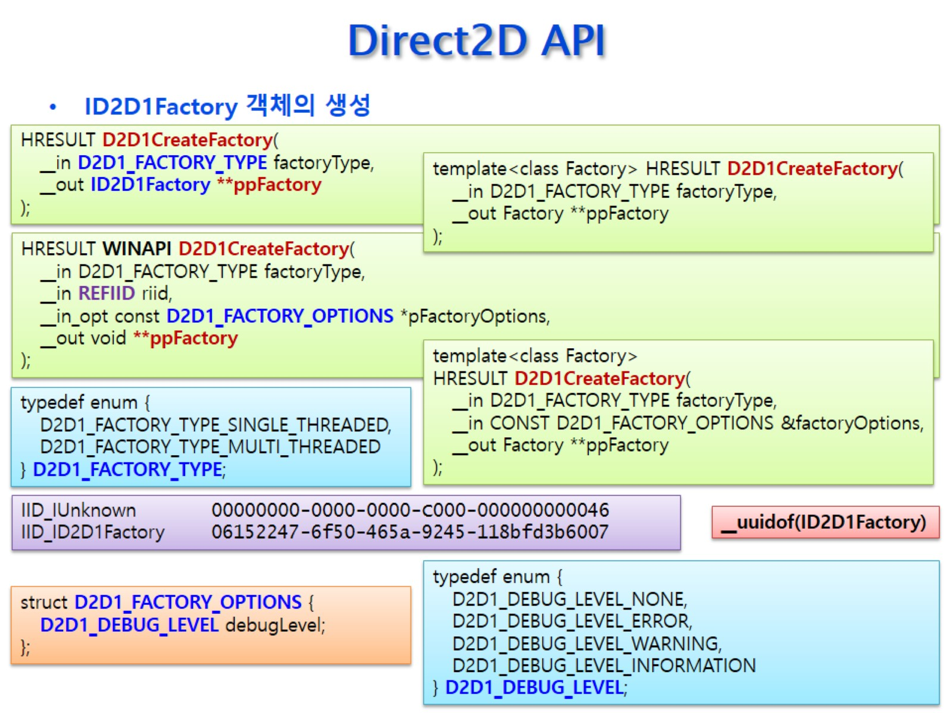
Direct2D API

Slide 14
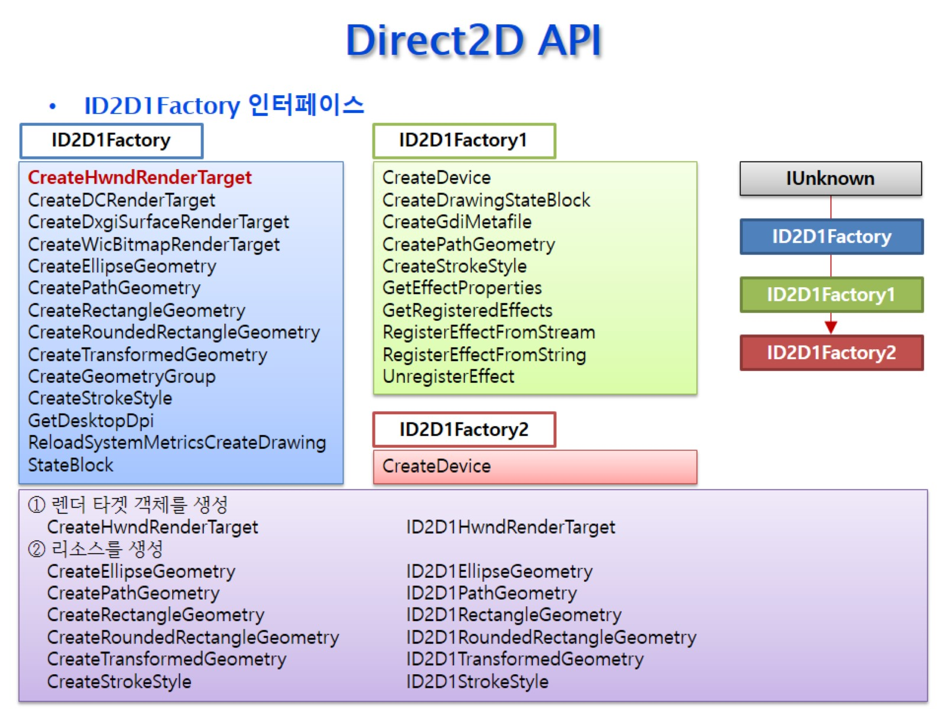
Direct2D API

Slide 15
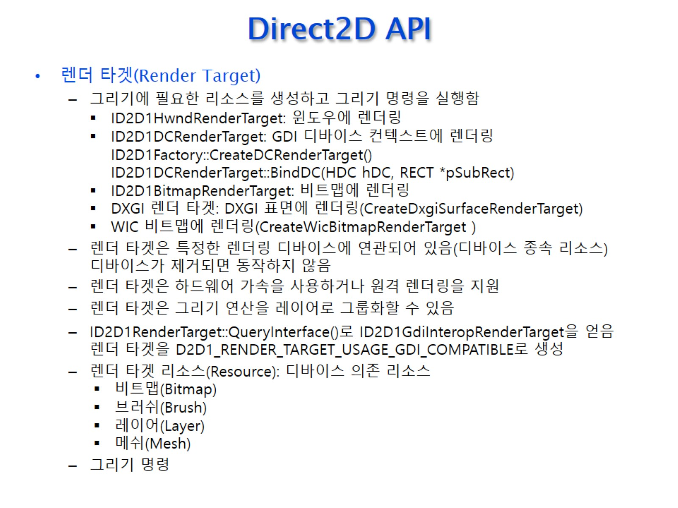
Direct2D API

Slide 16
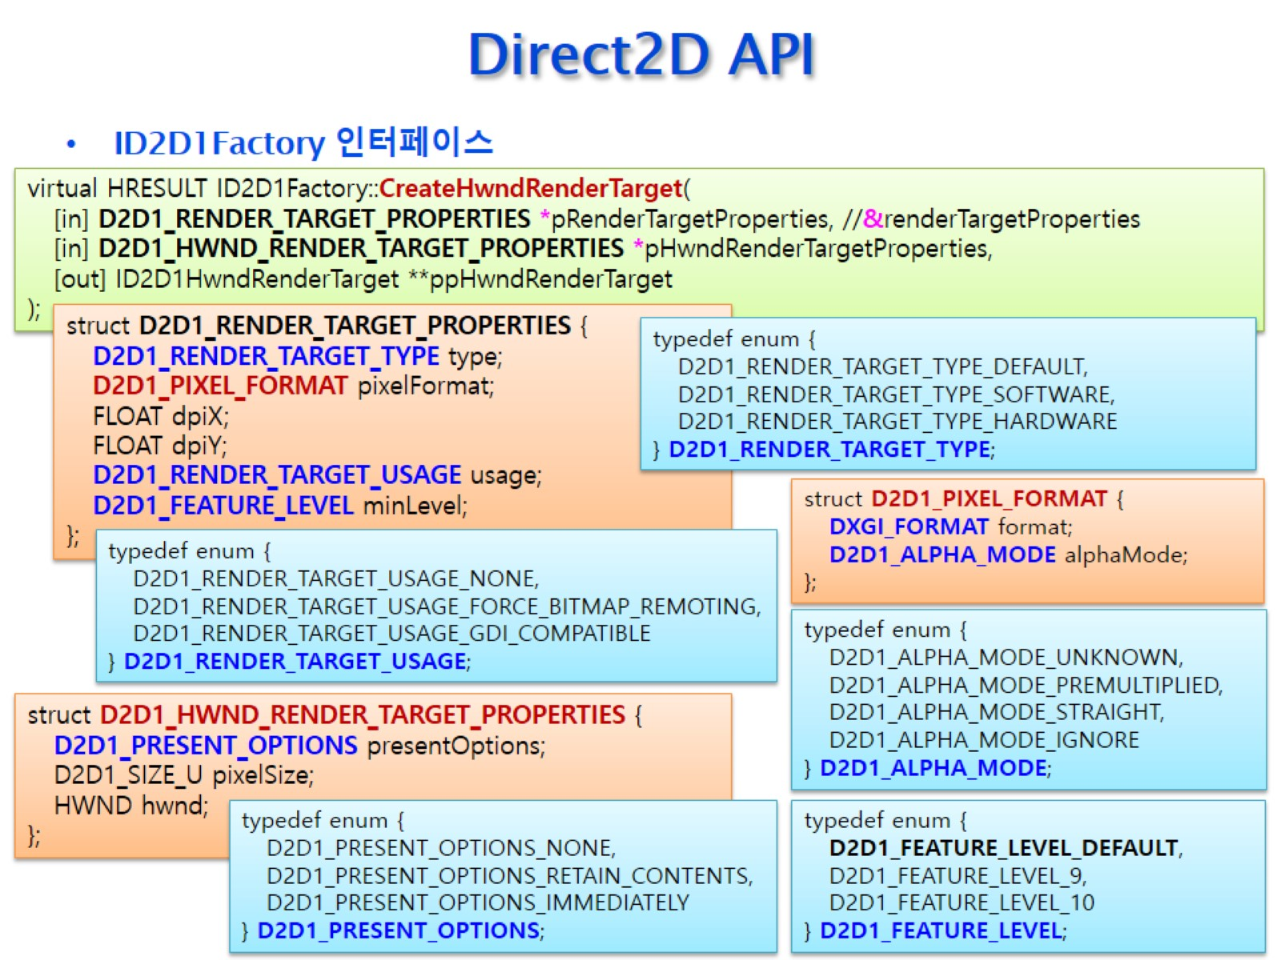
Direct2D API

Slide 17
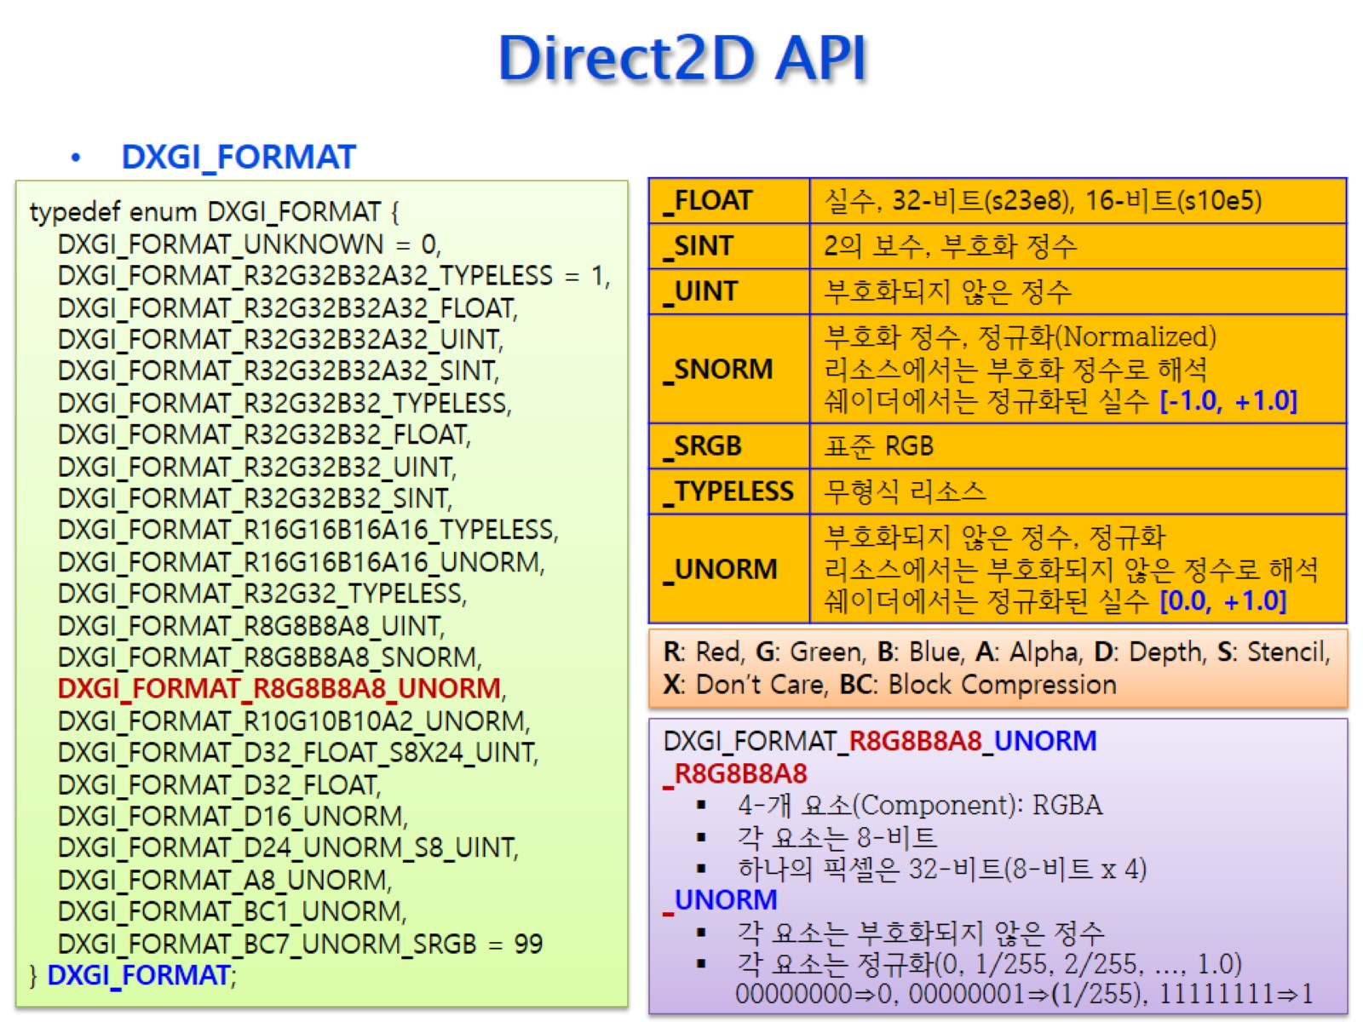
Direct2D API

Slide 18
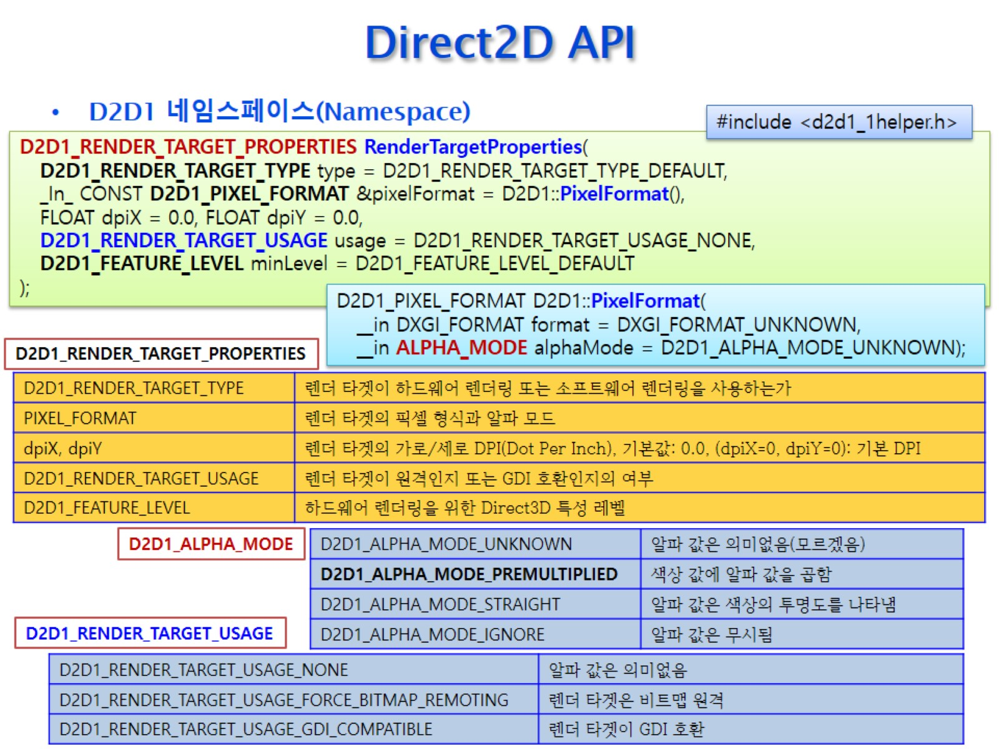
Direct2D API

Slide 19
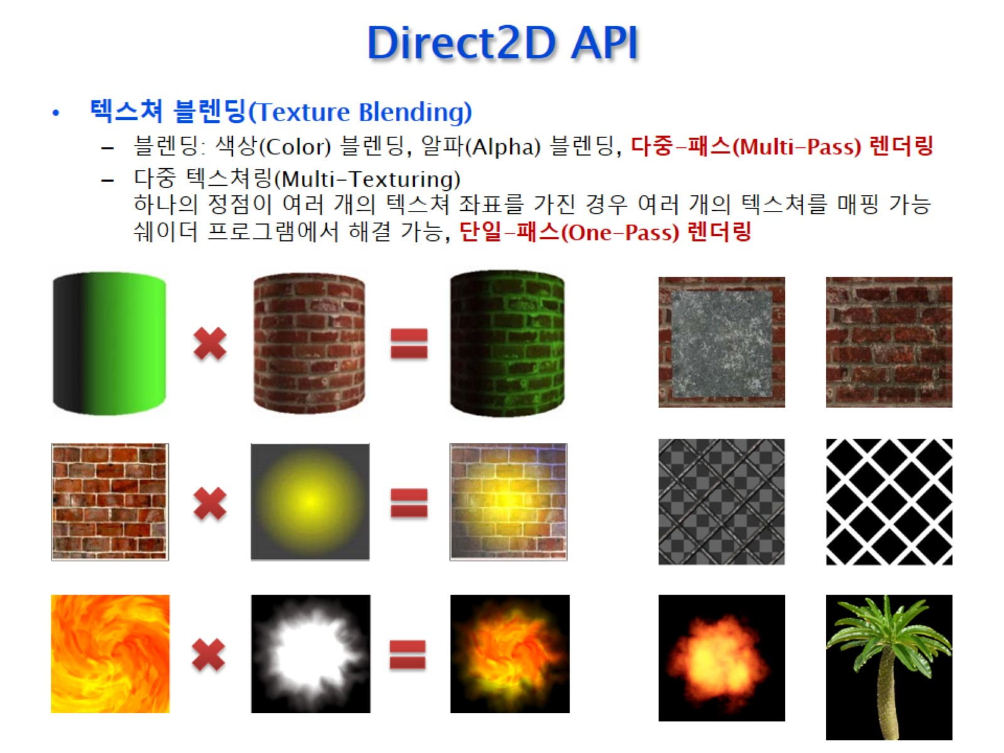
Direct2D API

Slide 20
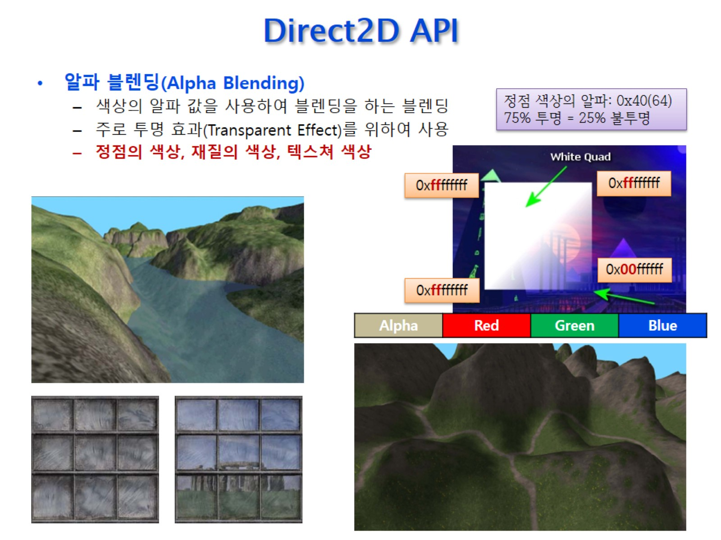
Direct2D API

Slide 21
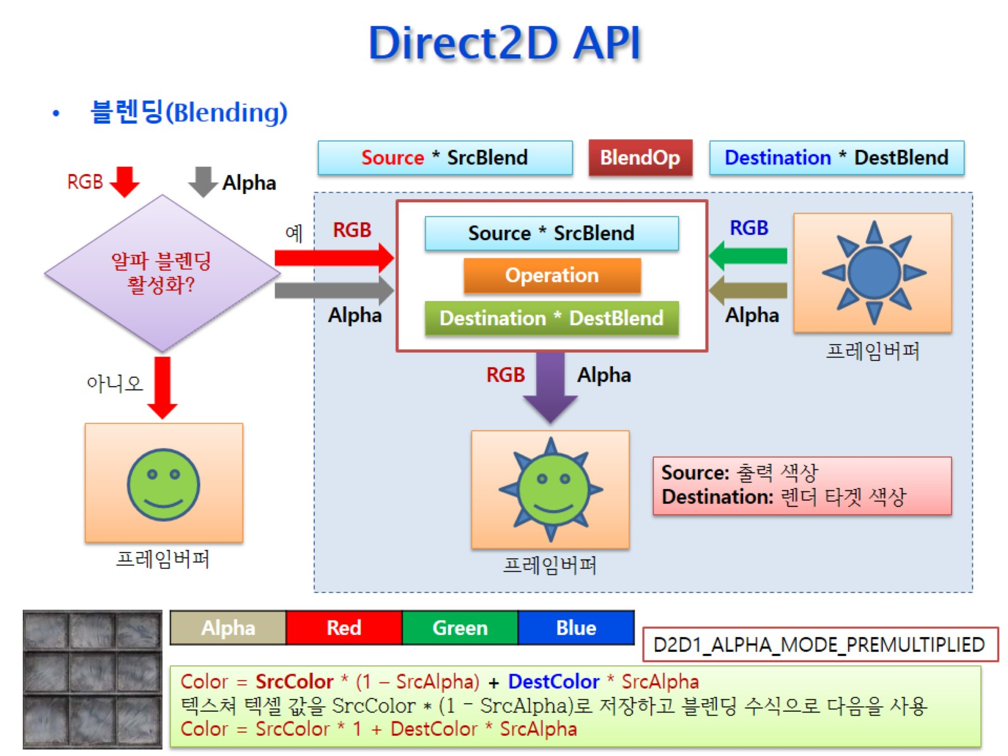
Direct2D API

Slide 22
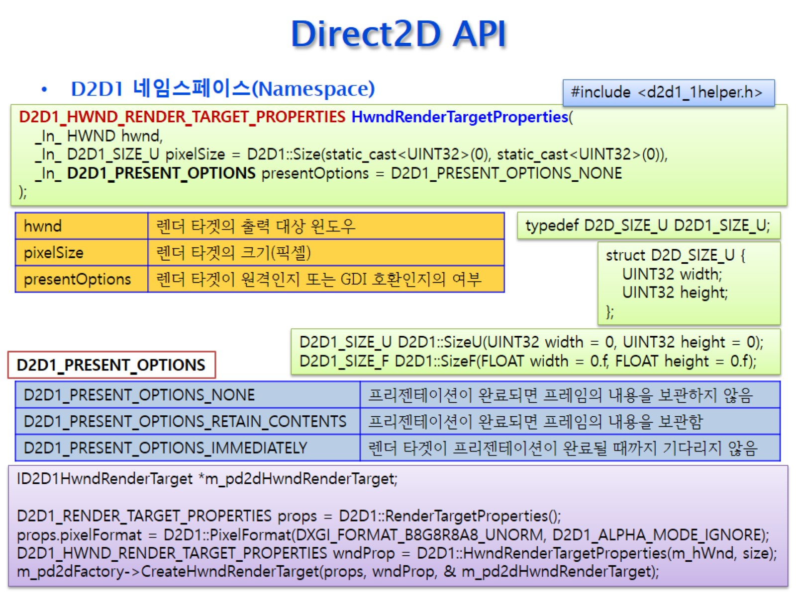
Direct2D API

Slide 23
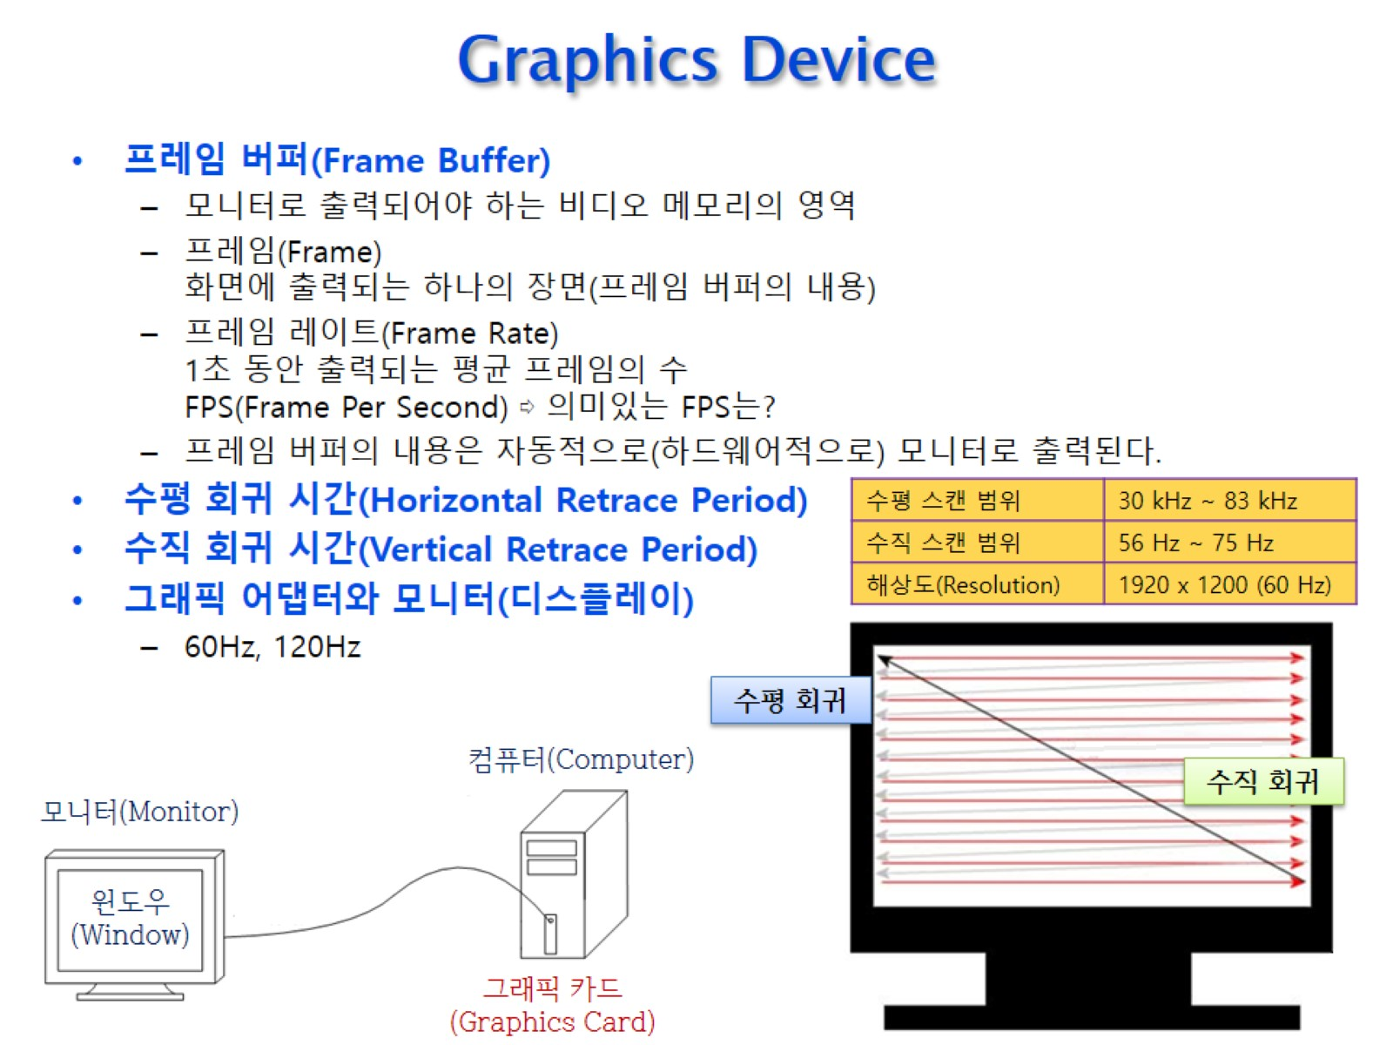
Graphics Device

Slide 24
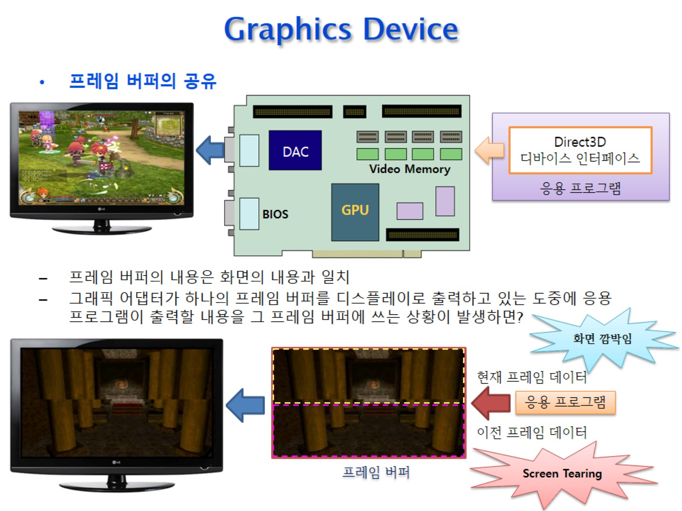
Graphics Device

Slide 25
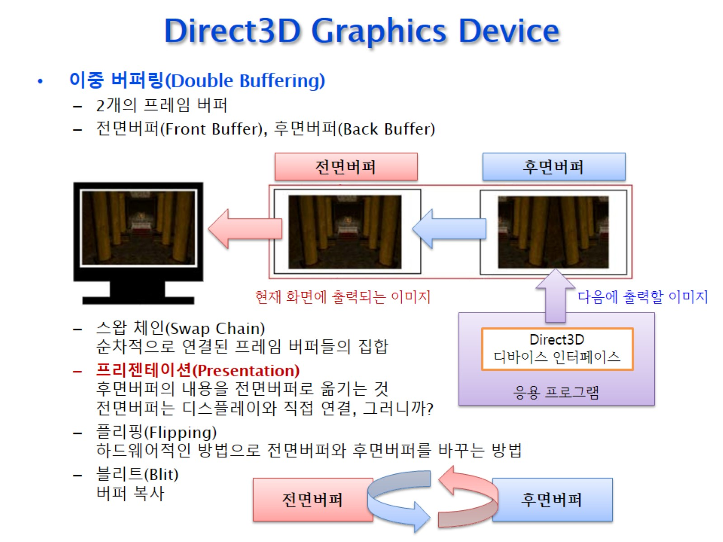
Direct3D Graphics Device

Slide 26
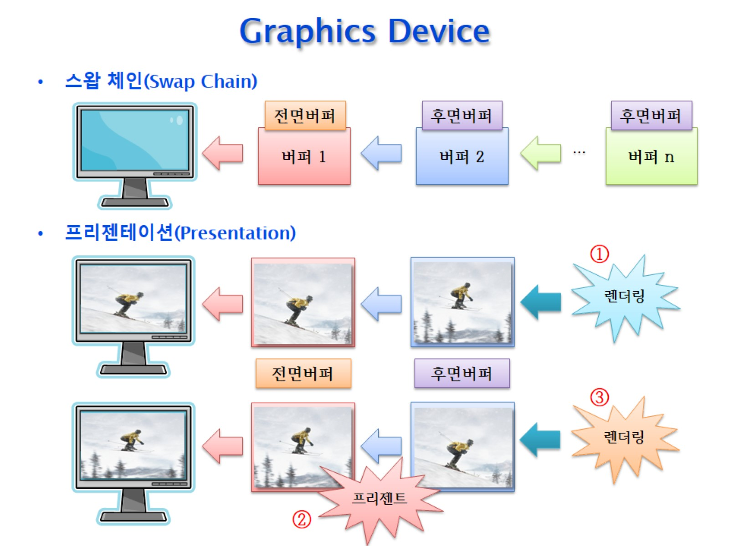
Graphics Device

Slide 27
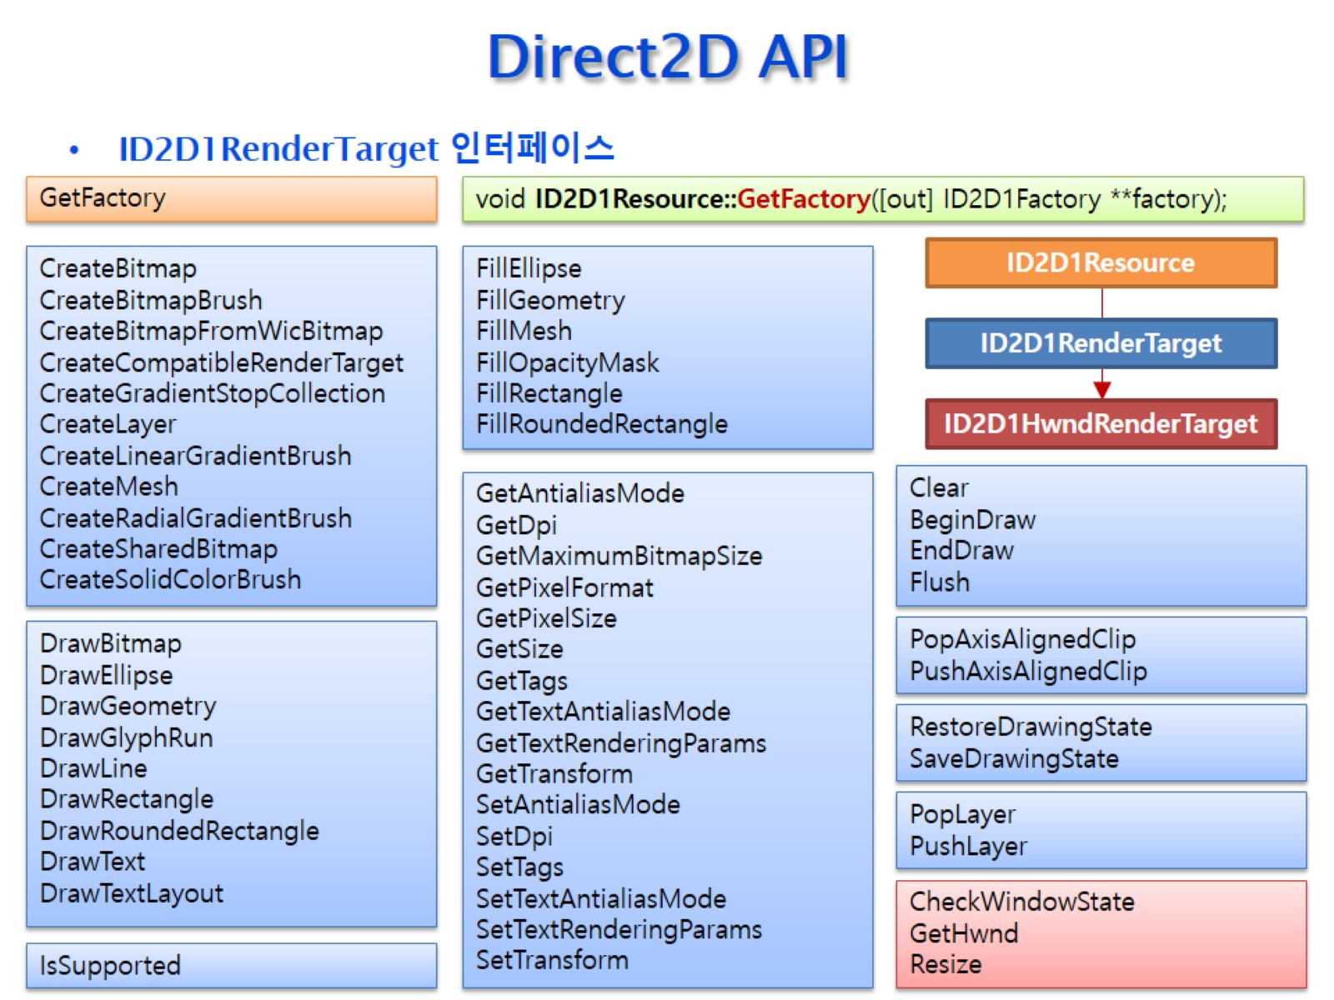
Direct2D API

Slide 28
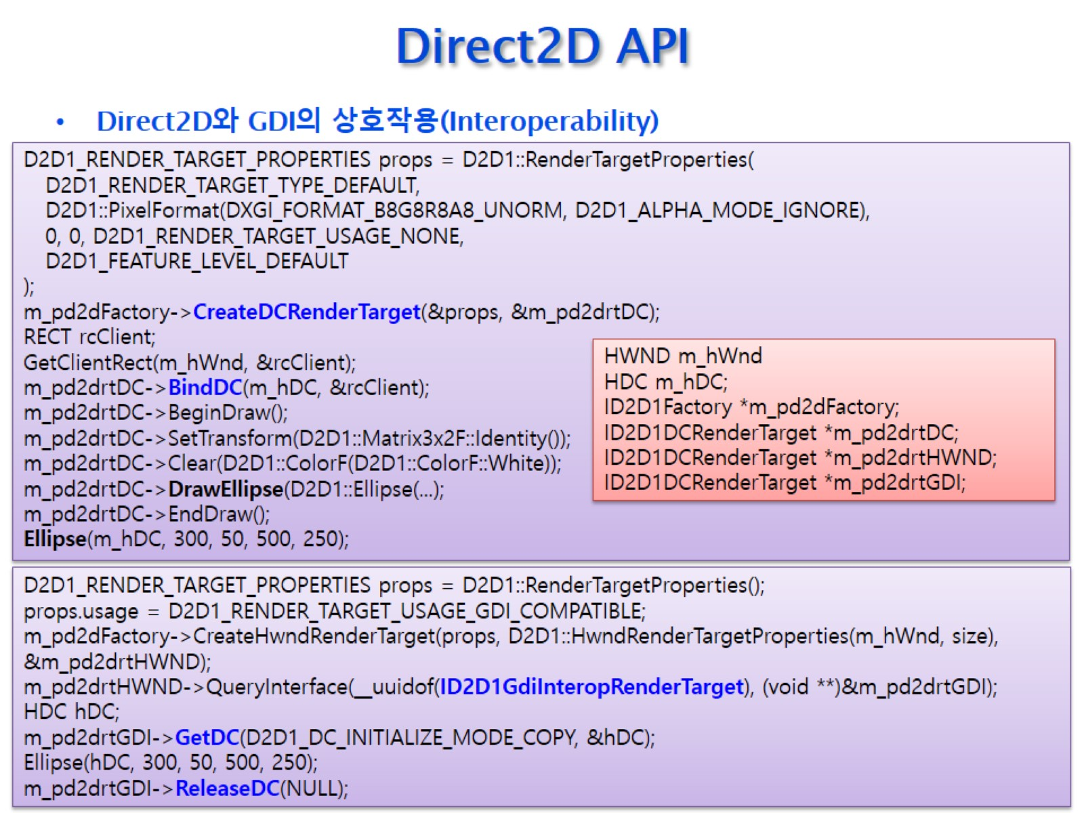
Direct2D API

Slide 29
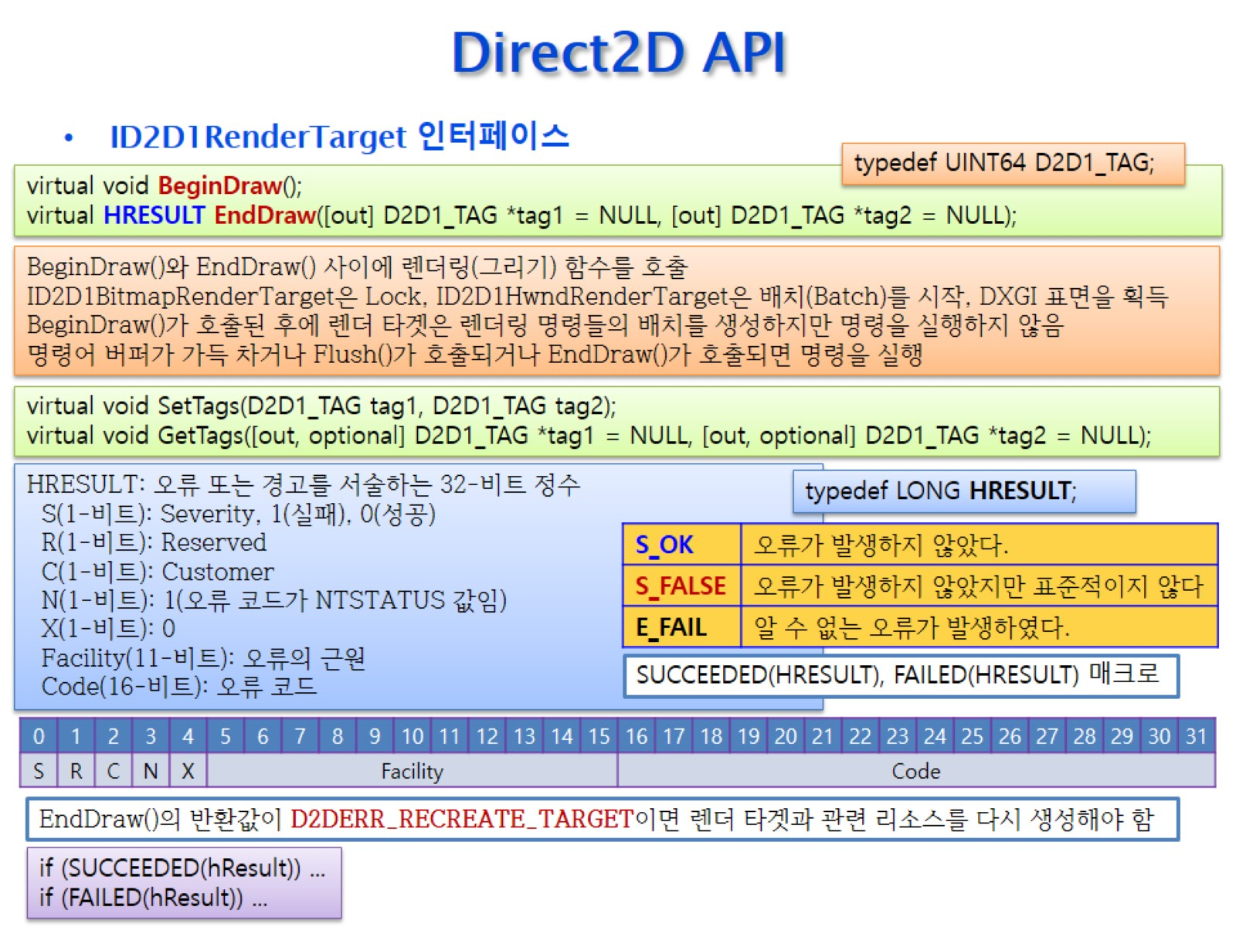
Direct2D API

Slide 30
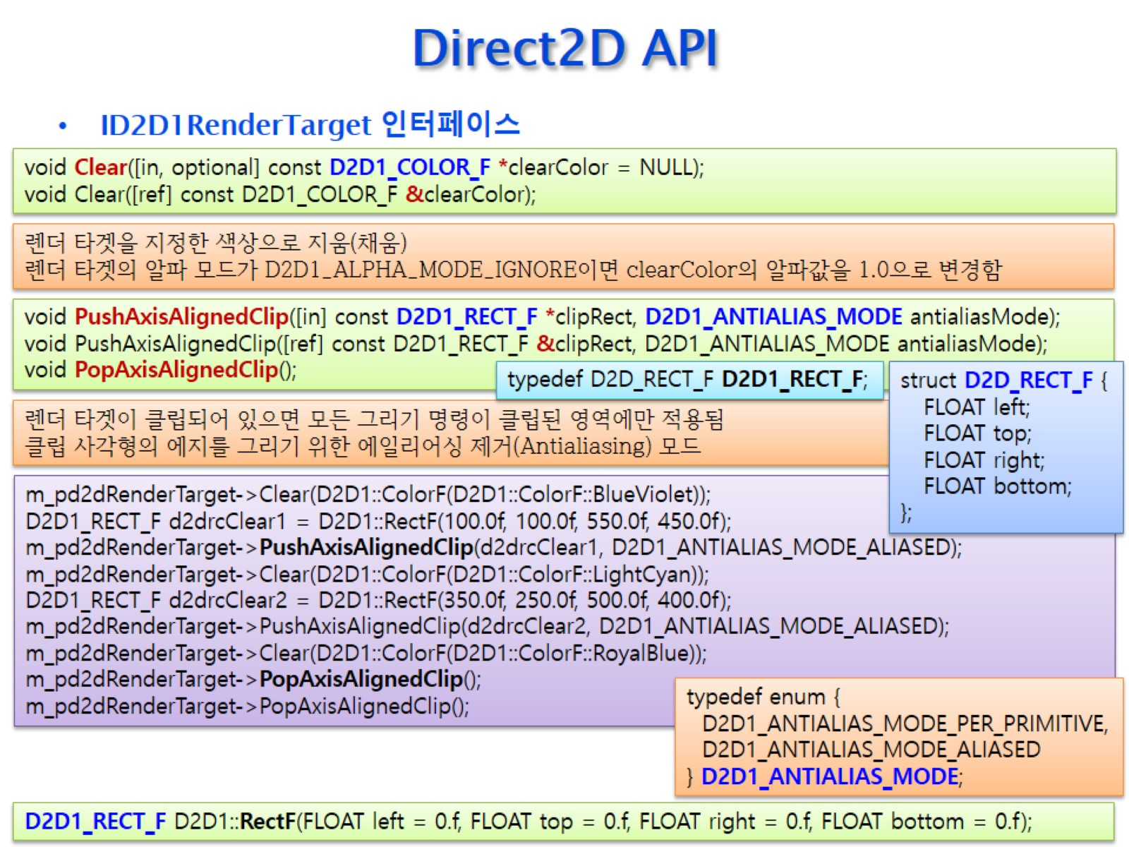
Direct2D API

Slide 31
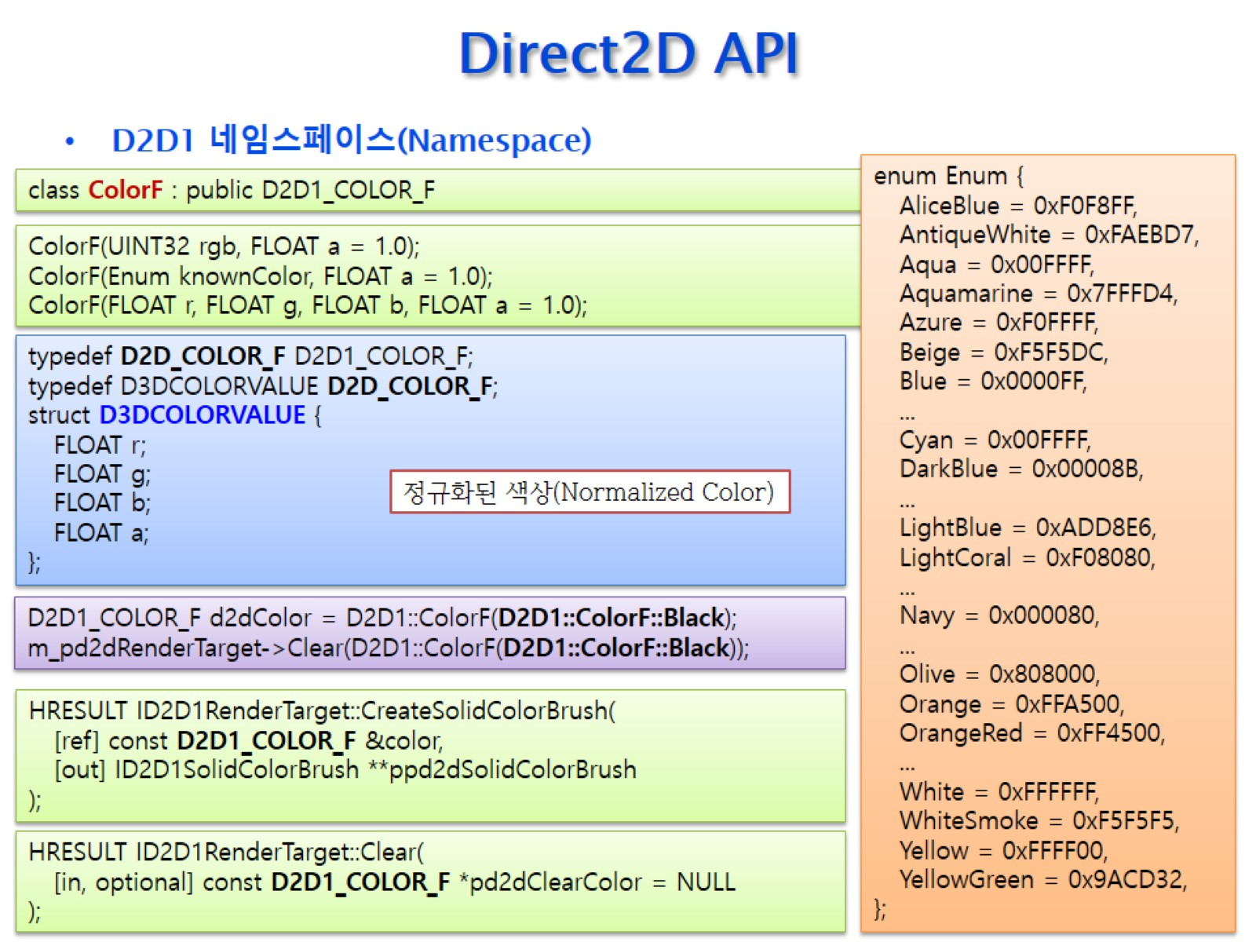
Direct2D API

Slide 32
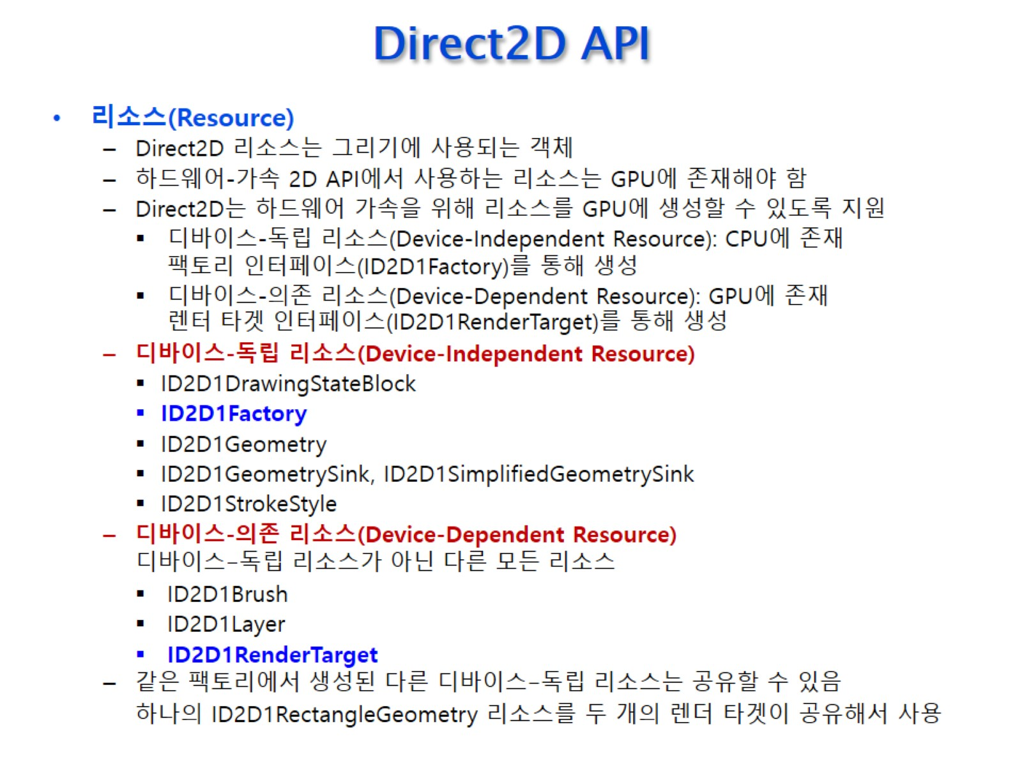
Direct2D API

Slide 33
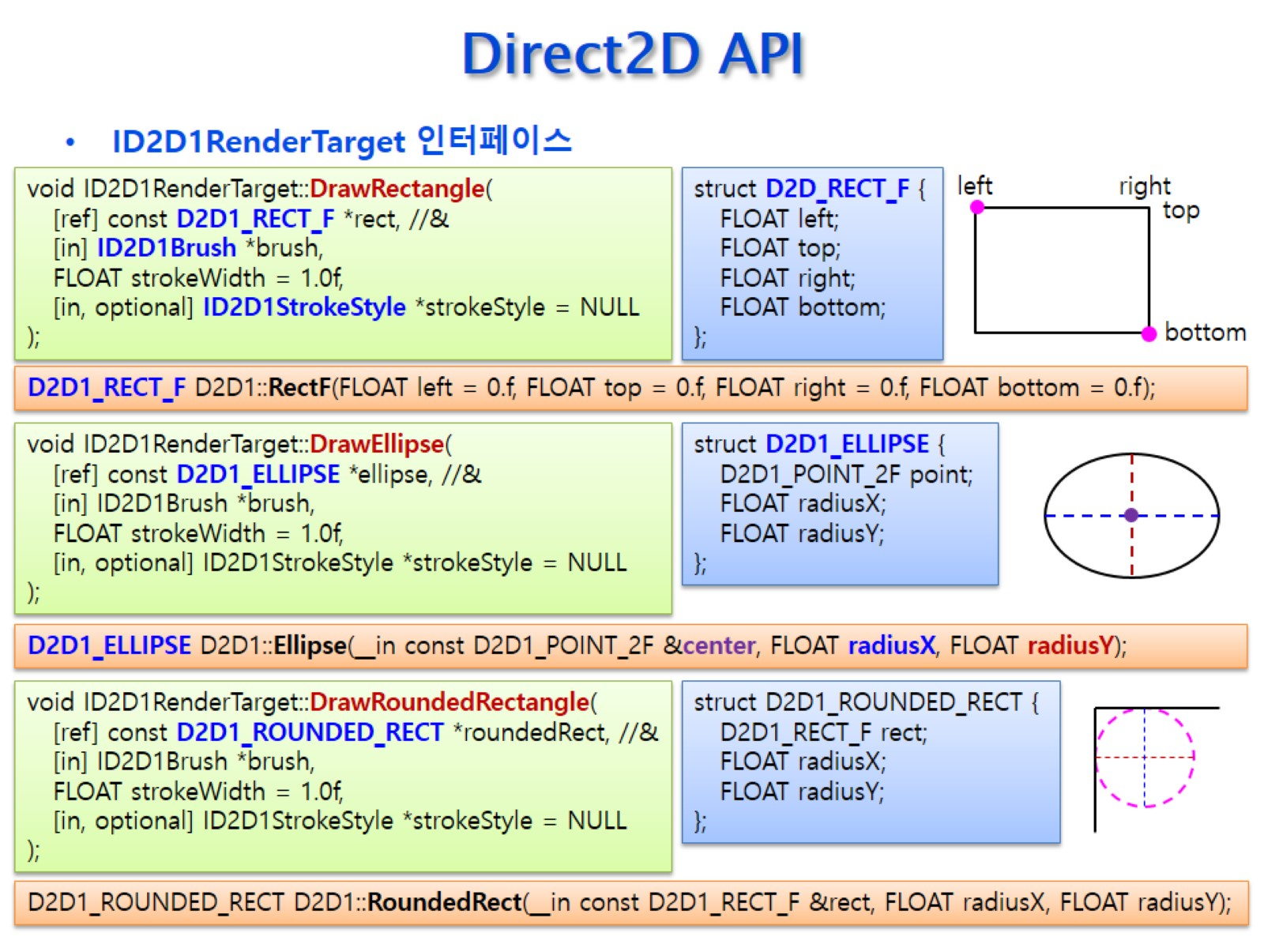
Direct2D API

Slide 34
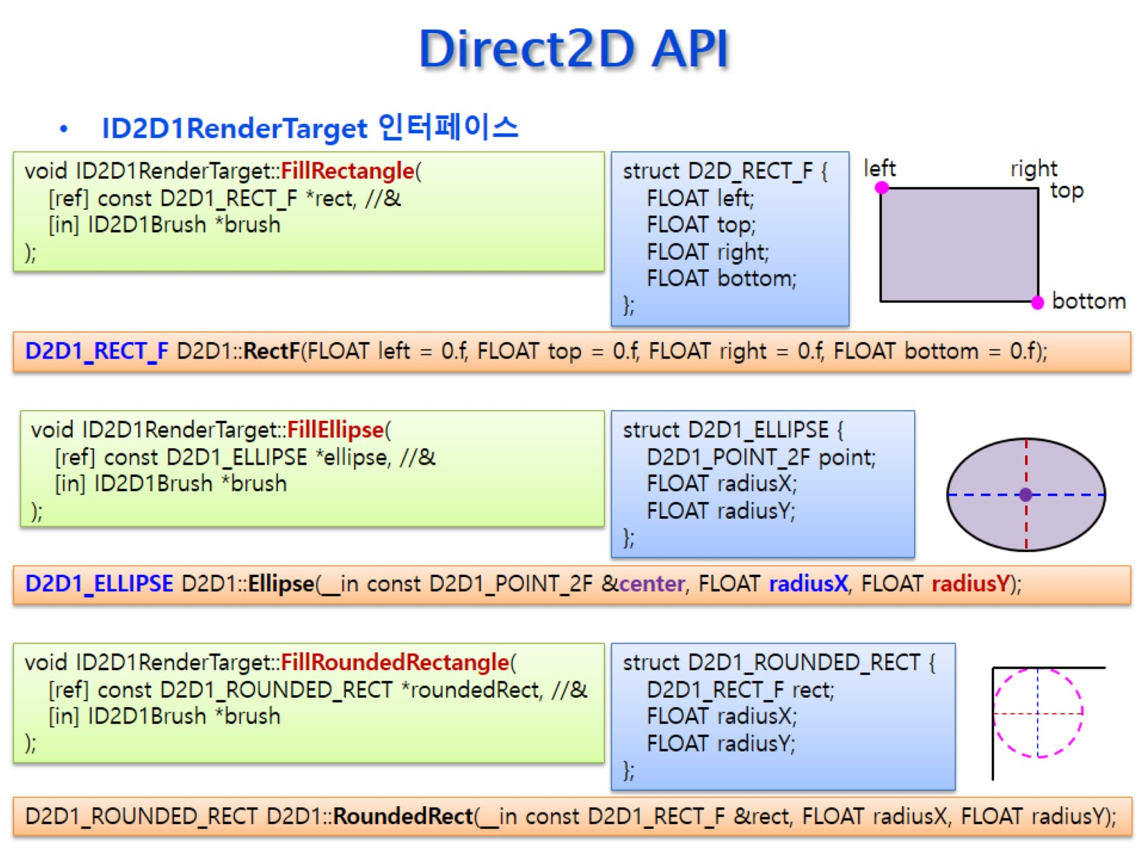
Direct2D API

Slide 35
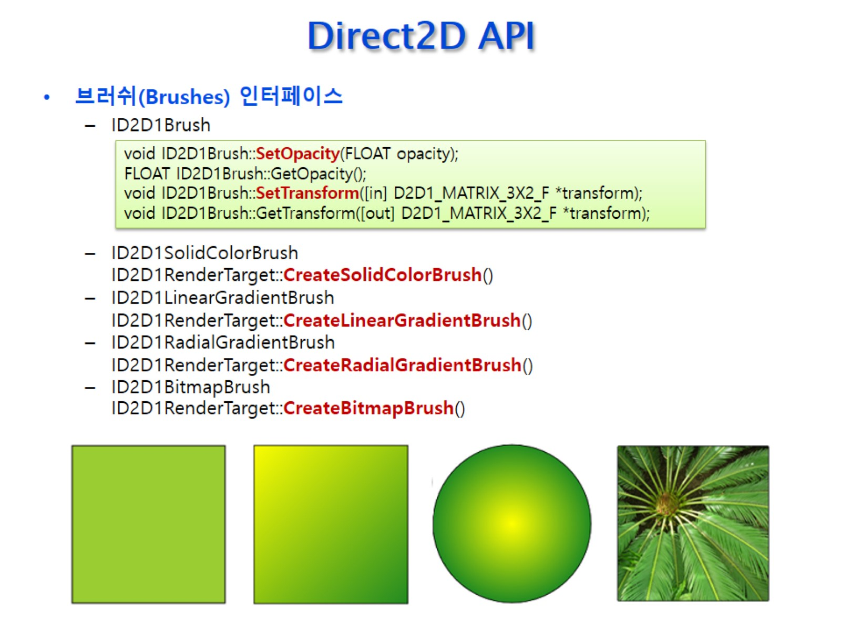
Direct2D API

Slide 36
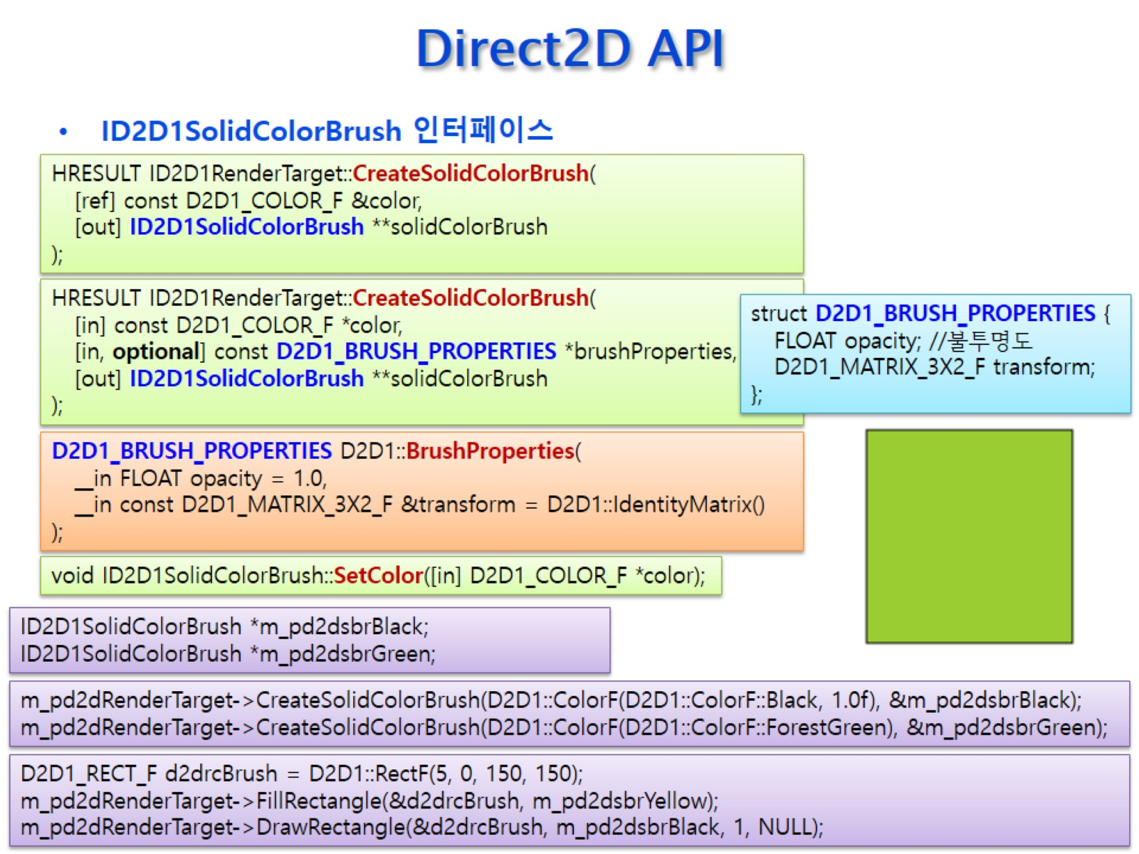
Direct2D API

Slide 37
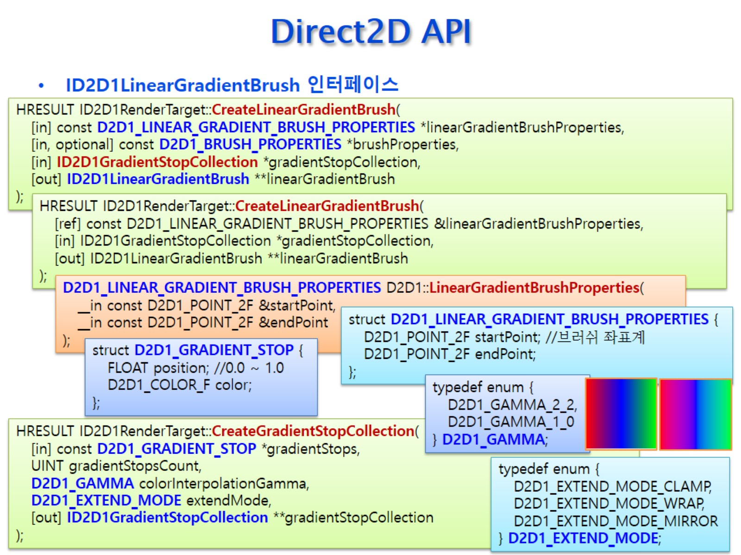
Direct2D API

Slide 38
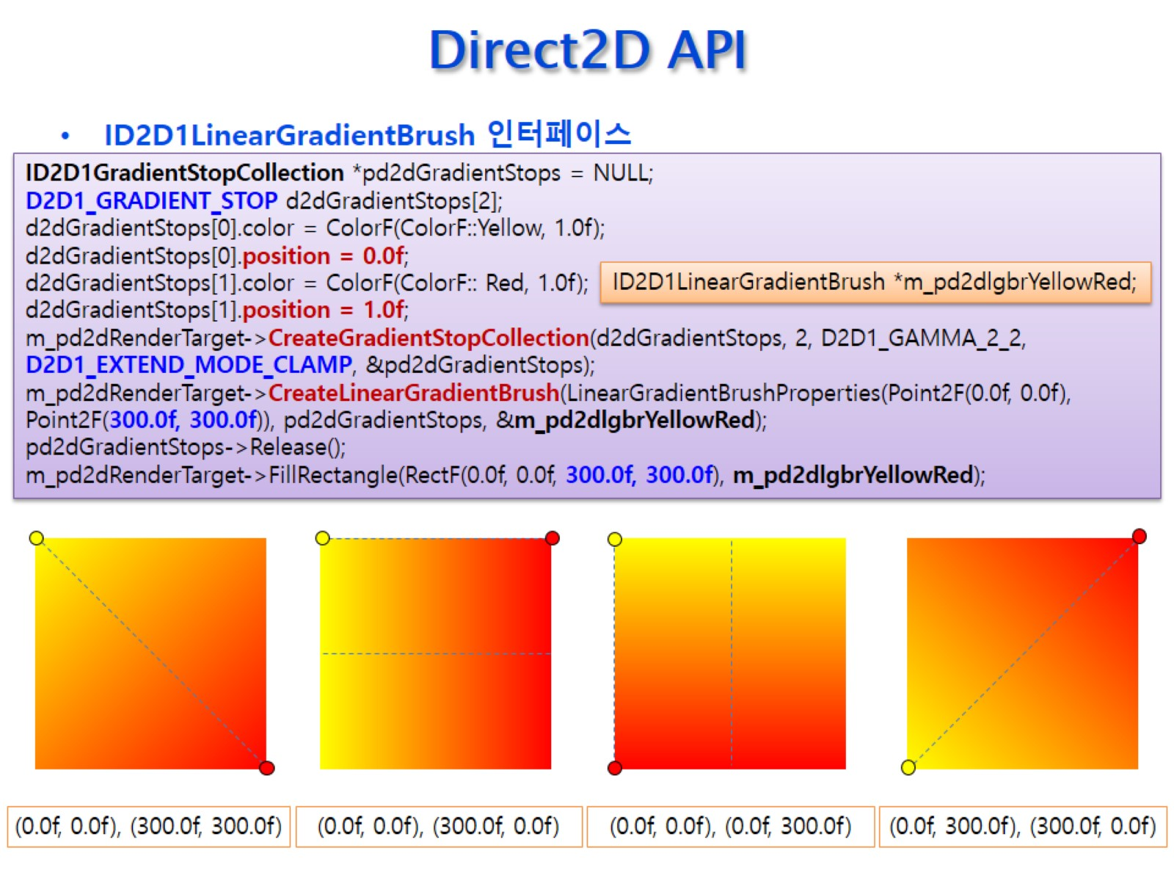
Direct2D API

Slide 39
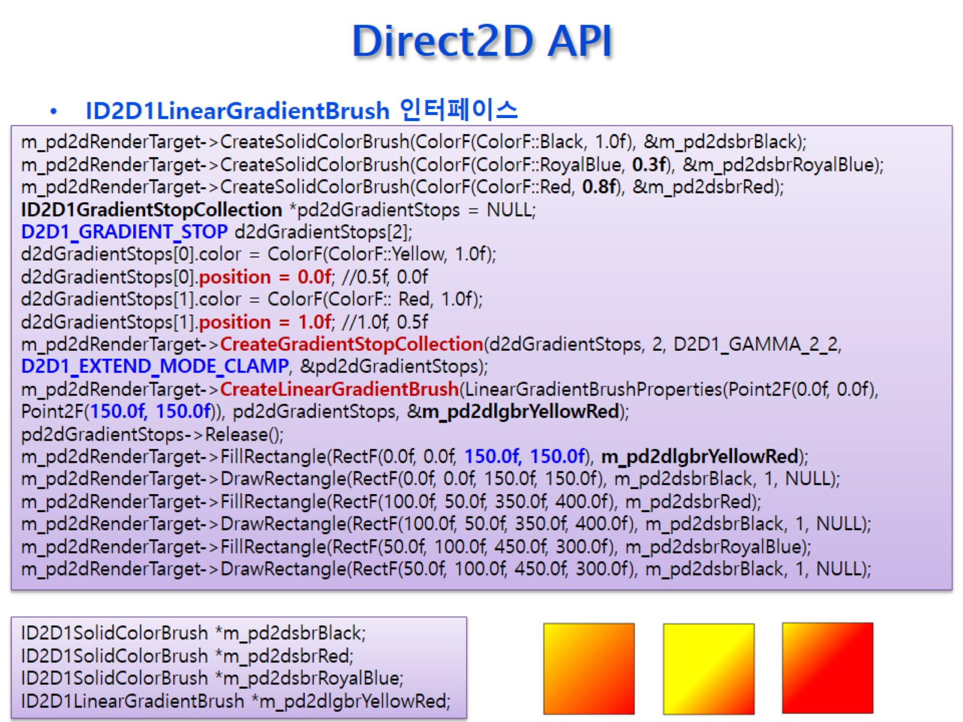
Direct2D API

Slide 40
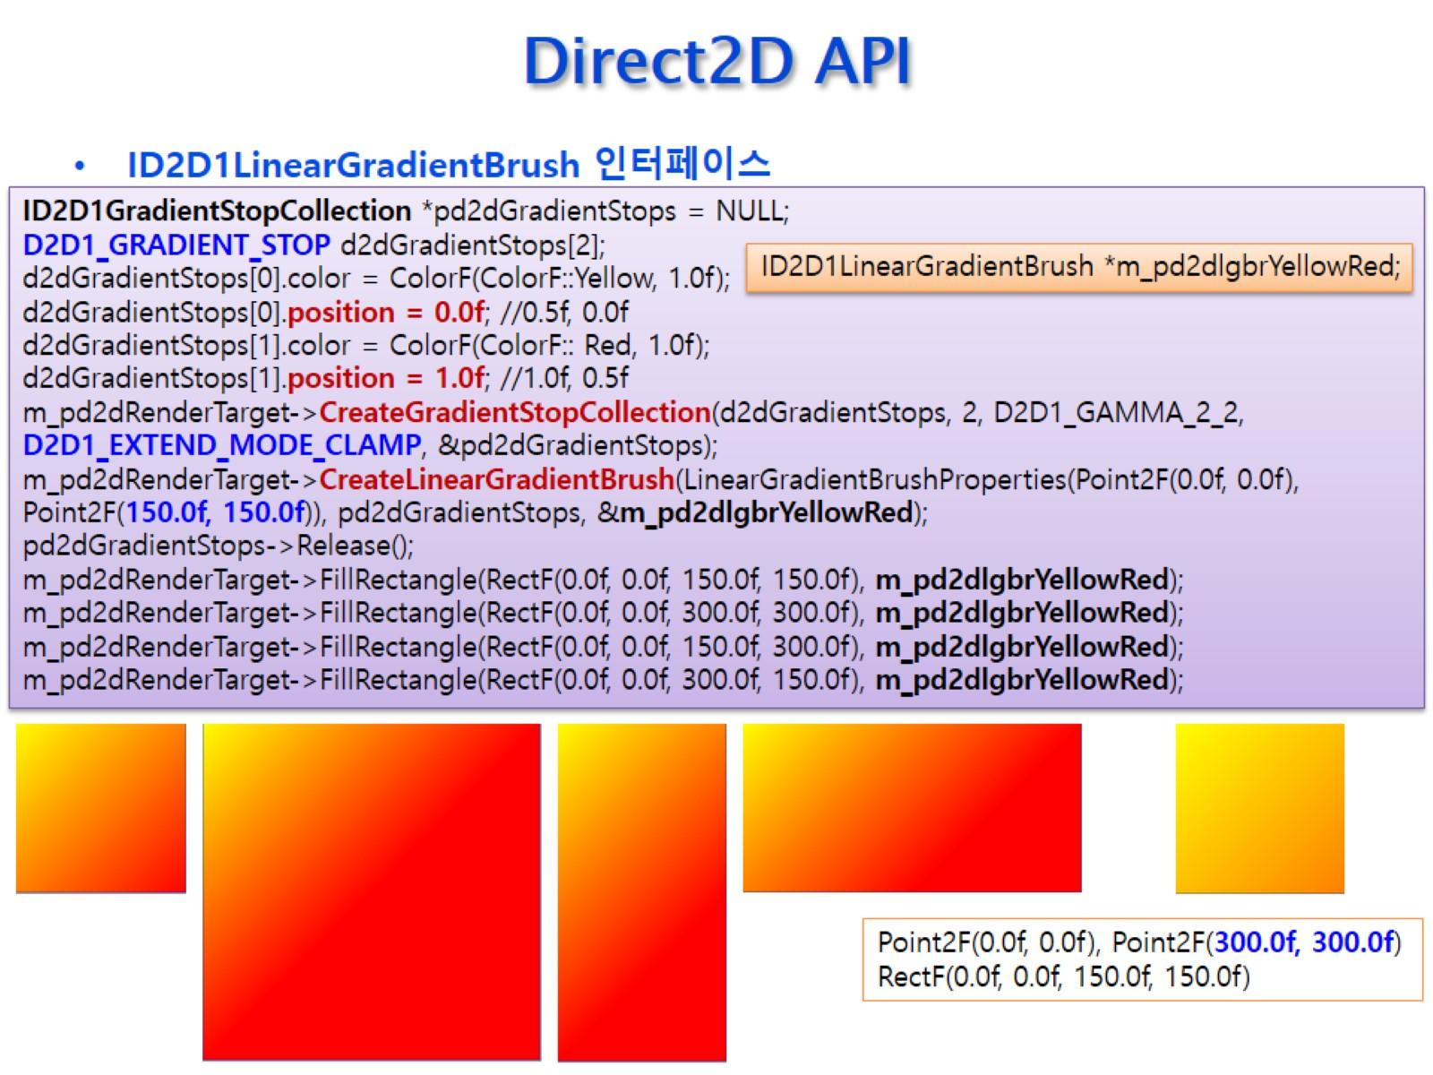
Direct2D API

Slide 41
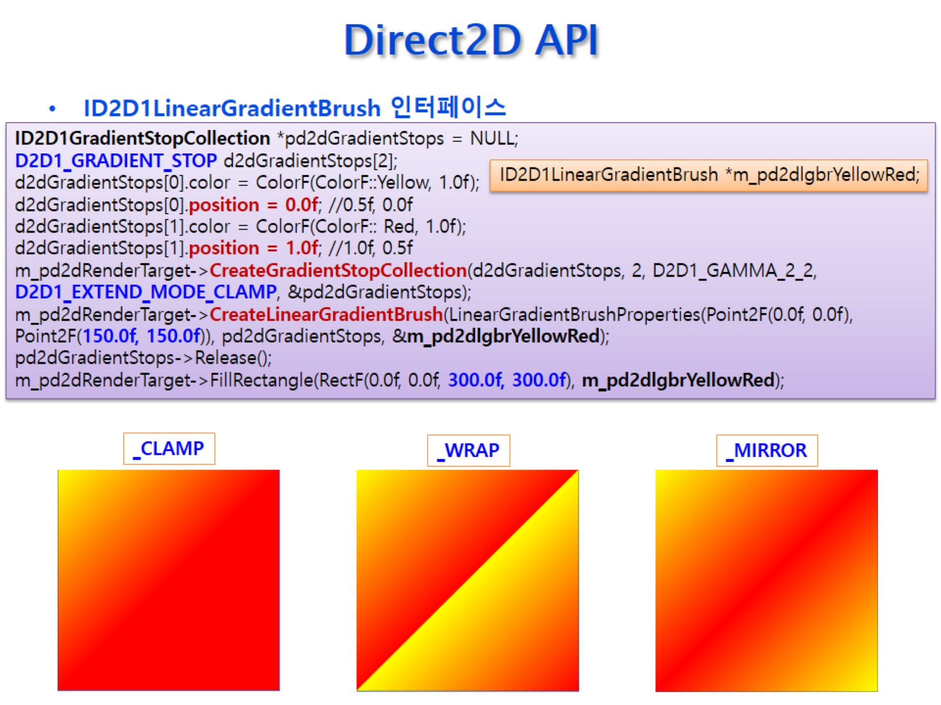
Direct2D API

Slide 42
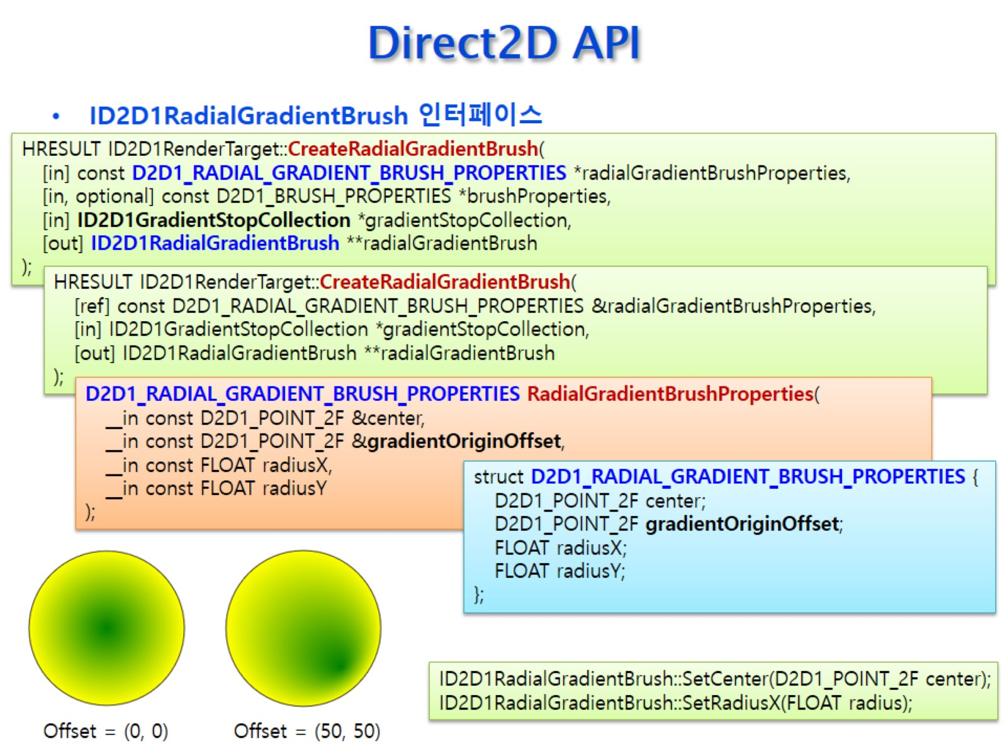
Direct2D API

Slide 43
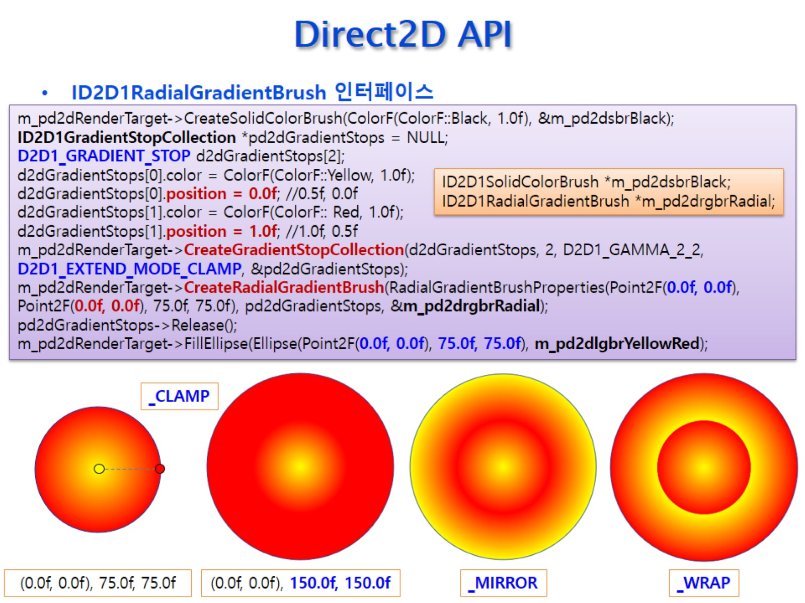
Direct2D API

Slide 44
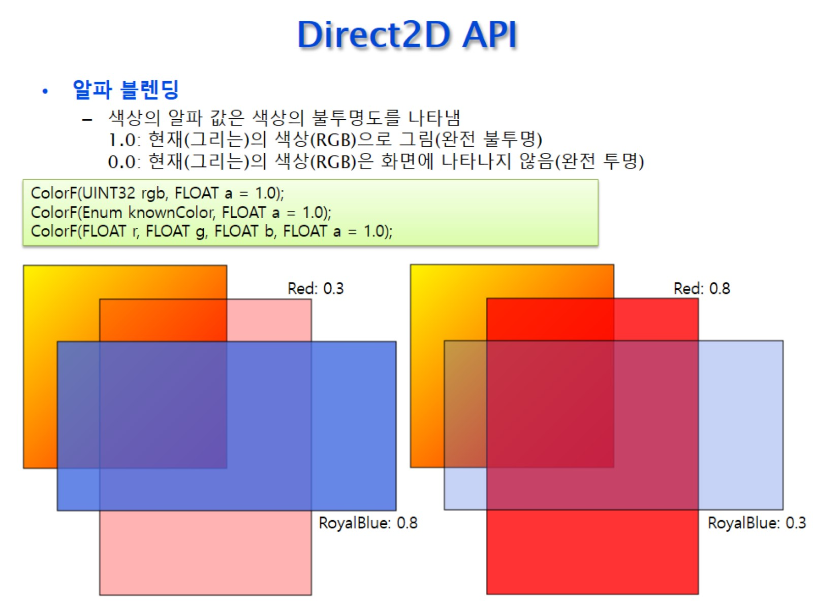
Direct2D API

Slide 45
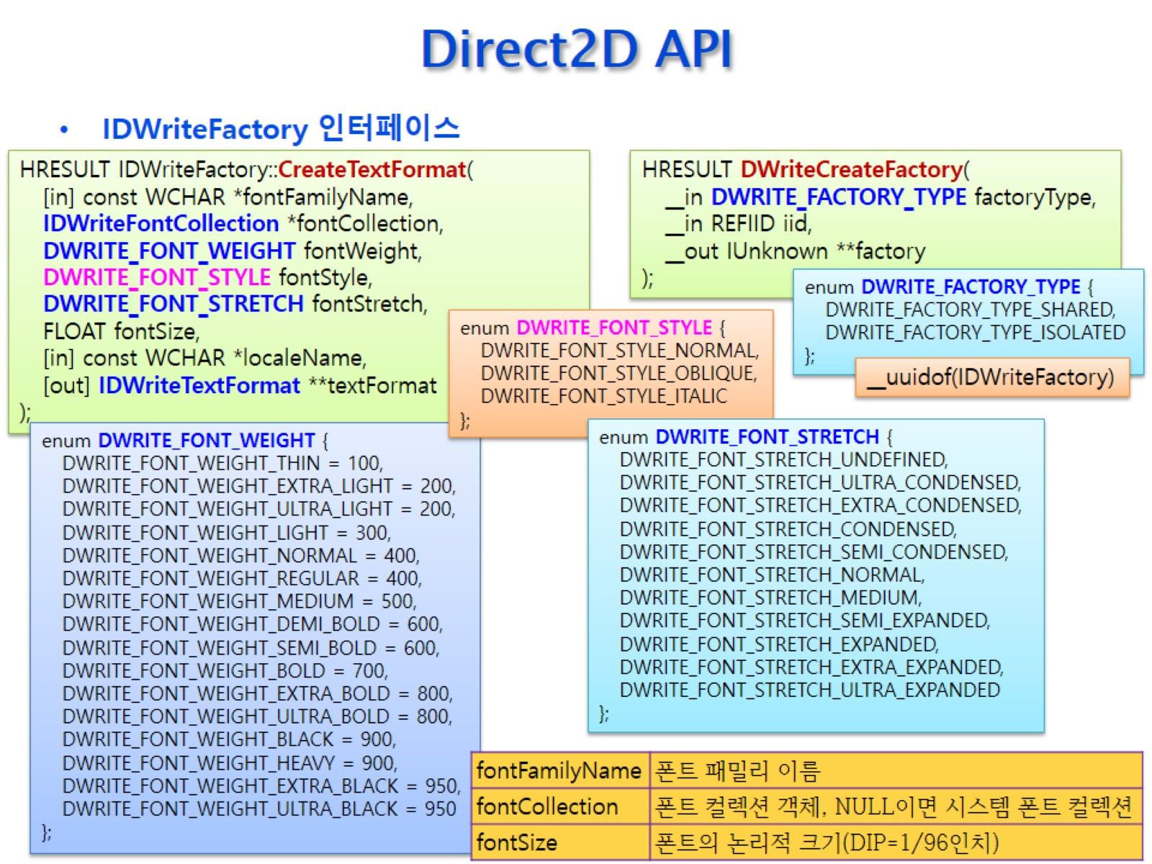
Direct2D API

Slide 46
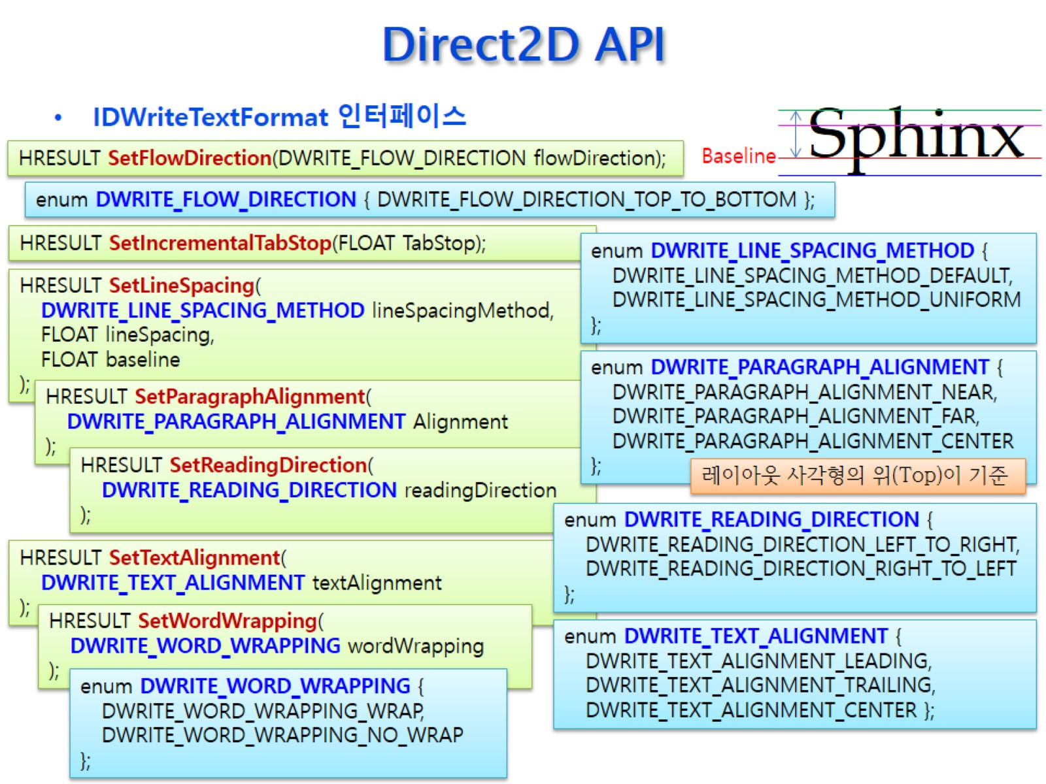
Direct2D API

Slide 47
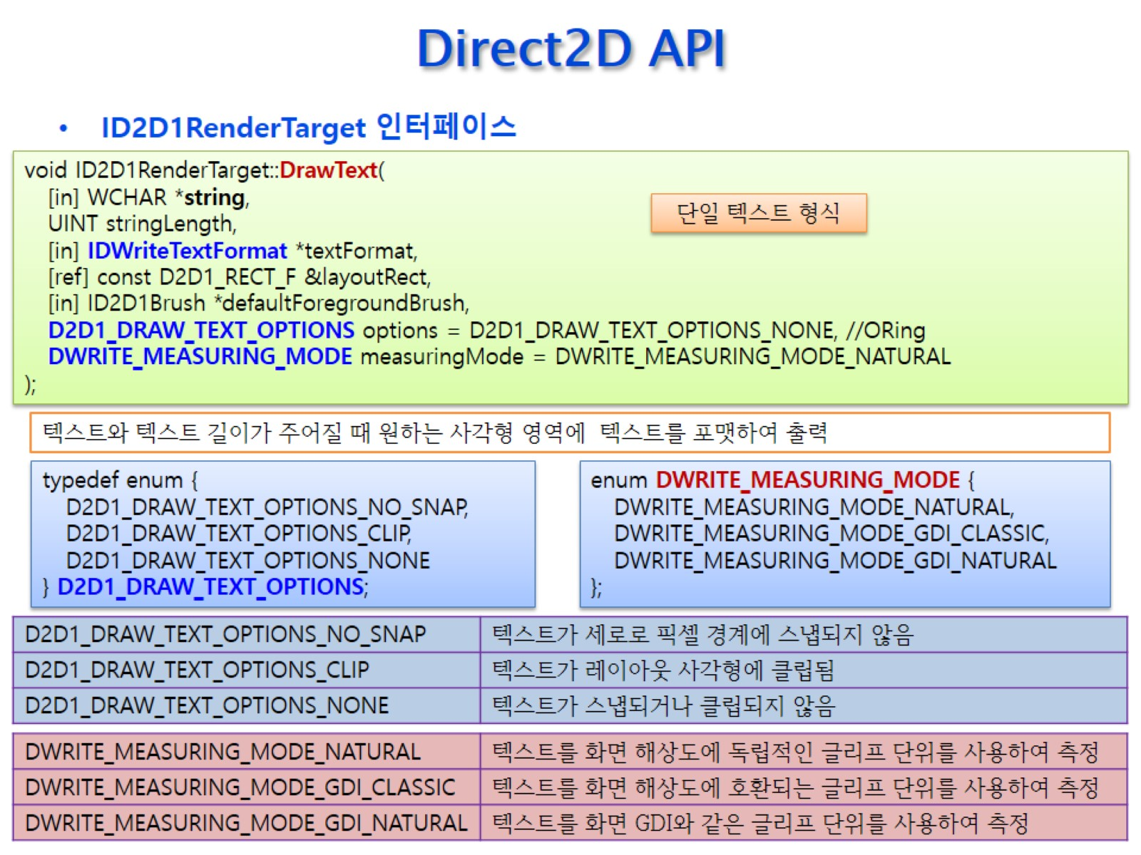
Direct2D API

Slide 48
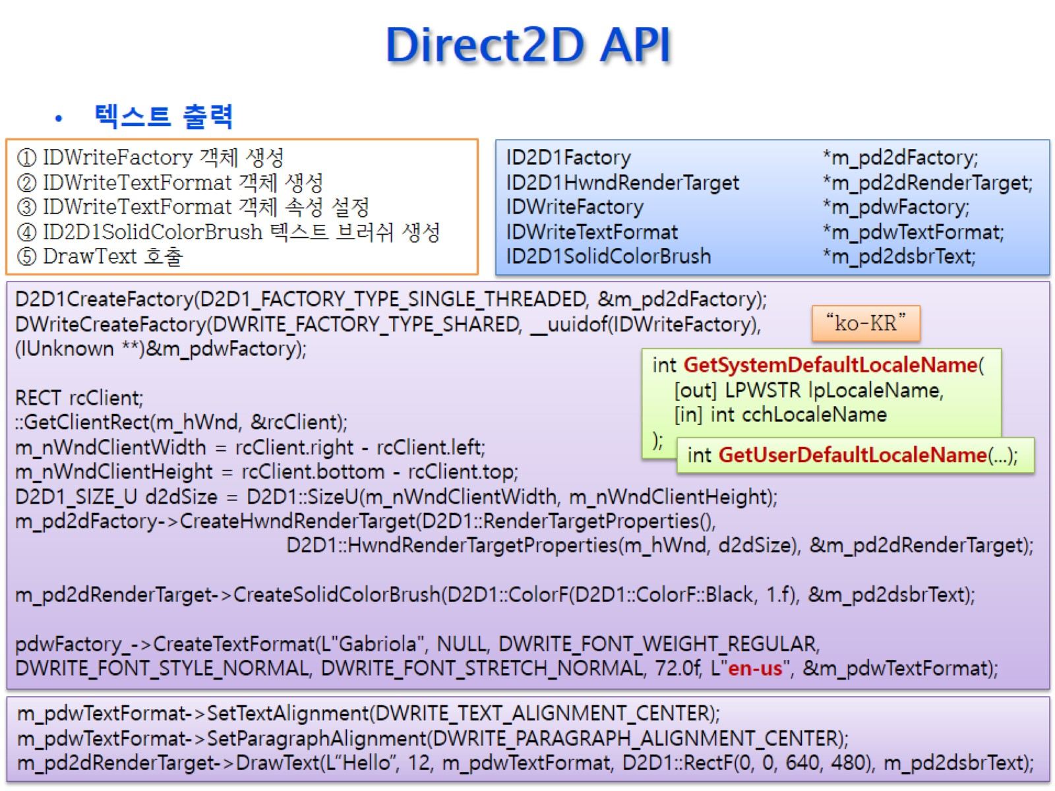
Direct2D API

Slide 49
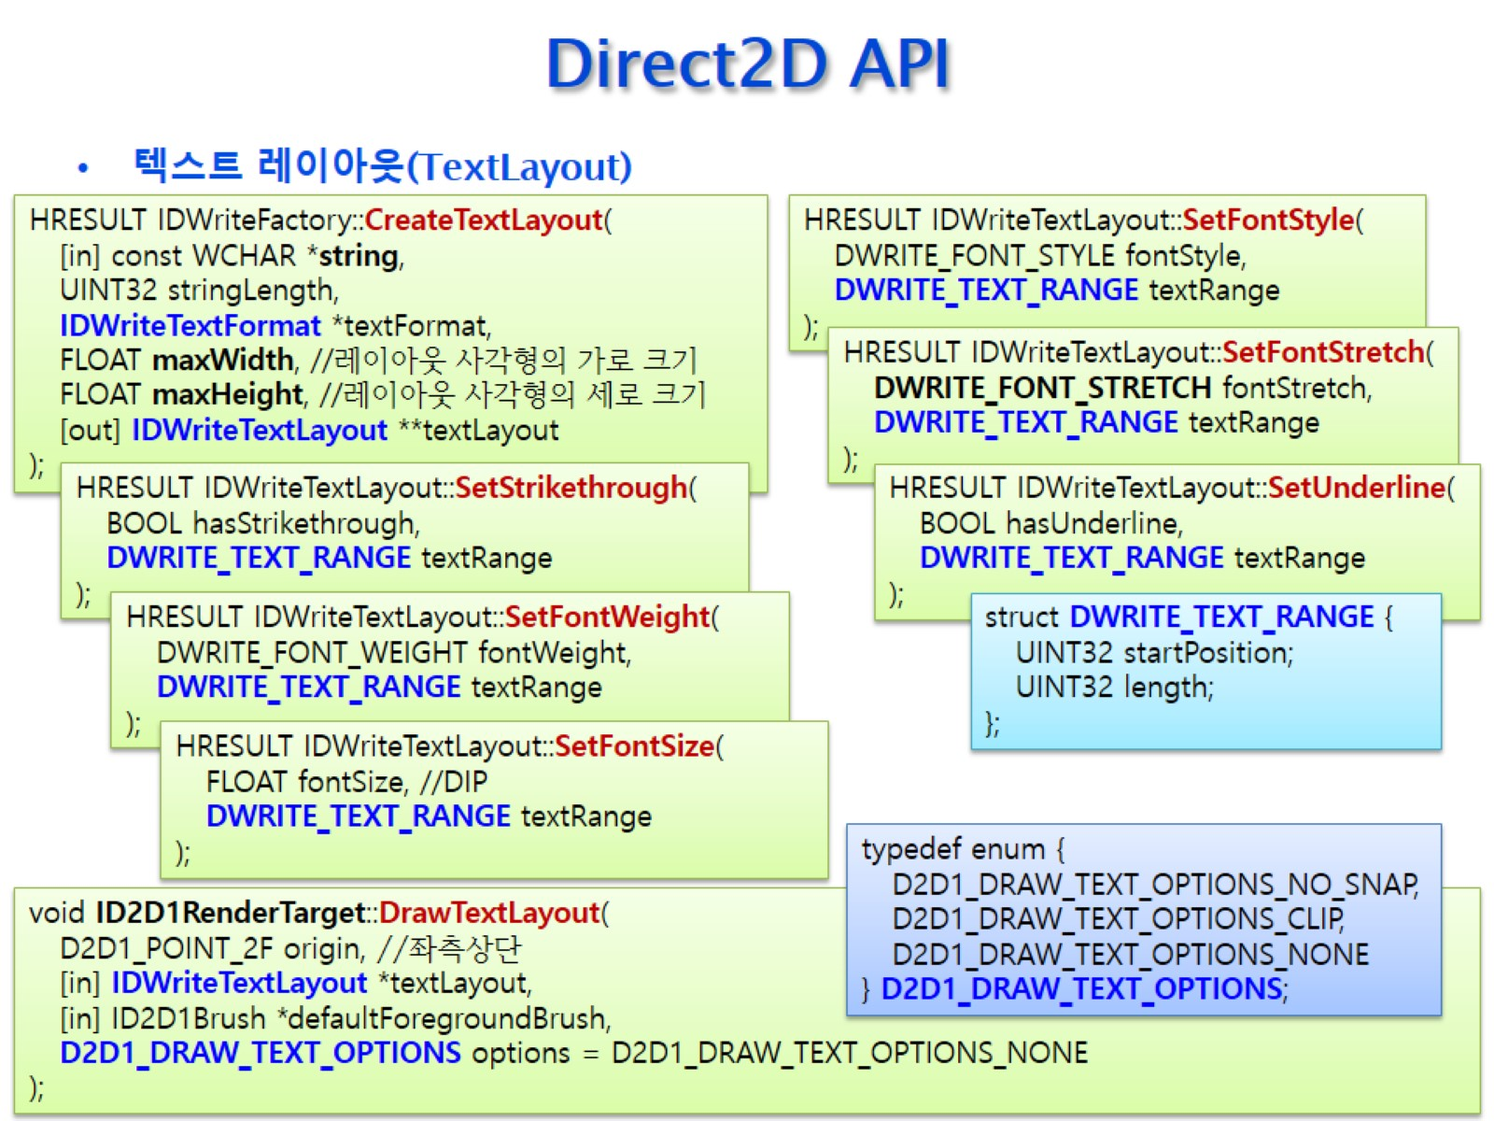
Direct2D API

Slide 50
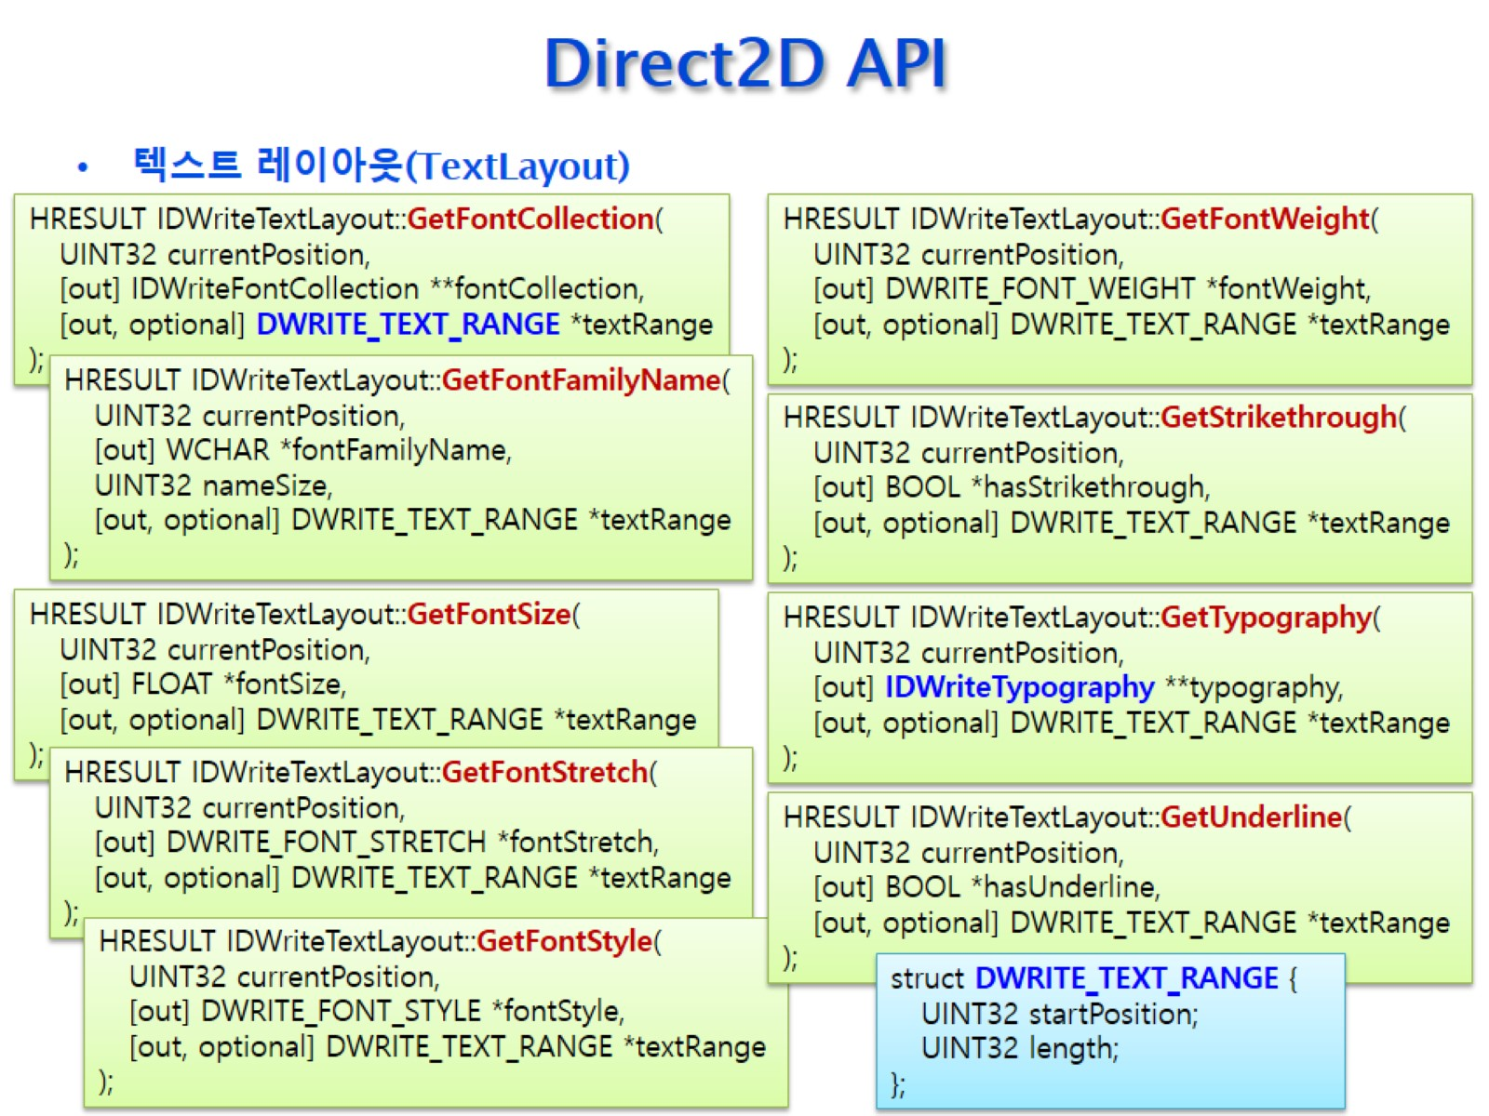
Direct2D API

Slide 51

Direct2D API

Slide 52

Direct2D API

Slide 53

Direct2D API

Slide 54

Direct2D API

Slide 55

Direct2D API

Slide 56

Direct2D API

Slide 57

Direct2D API

Slide 58

Direct2D API

Slide 59

Direct2D API

Slide 60

Direct2D API

Slide 61

Direct2D API

Slide 62

Direct2D API

Slide 63

Direct2D API

Slide 64

Direct2D API

Slide 65

변환과 행렬(Transform and Matrix)

Slide 66

변환과 행렬(Transform and Matrix)

Slide 67

변환과 행렬(Transform and Matrix)

Slide 68

변환과 행렬(Transform and Matrix)

Slide 69

변환과 행렬(Transform and Matrix)

Slide 70

변환과 행렬(Transform and Matrix)

Slide 71

변환과 행렬(Transform and Matrix)

Slide 72

변환과 행렬(Transform and Matrix)

Slide 73

변환과 행렬(Transform and Matrix)

Slide 74

변환과 행렬(Transform and Matrix)

Slide 75

변환과 행렬(Transform and Matrix)

Slide 76

변환과 행렬(Transform and Matrix)

Slide 77

변환과 행렬(Transform and Matrix)

Slide 78

Direct2D API

Slide 79

Direct2D API

Slide 80

Direct2D API

Slide 81

Direct2D API

